Slide 1
2025 Begins Here:
Seize the Moment
with 2025 Iconic
Screens
www.masscomglobal.com

Slide 2
Why
programmatic DOOH for KSA campaign targeting wealthy luxury audiences?
Benefits
of programmatic DOOH
Programmatic Advertising: Tailor your digital out-of-home (DOOH) campaigns with precision, targeting high-traffic areas near convention centres in real-time
Culturally Smart and Data-Driven: Seamlessly integrate diverse datasets to deliver content that resonates with the business community at the right moment.
Dynamic Campaign Activation: Data feeds initiate context-aware displays based on busy times, community events, and cultural celebrations, enhancing relevance and engagement.
Flexibility, Speed, and Modularity
Quick Campaign Setup
Dynamic Campaign Management
Unlike traditional methods, it enables real-time adaptation to external conditions and personalized ad delivery.
Benefits include increased efficiency, precise audience targeting, and improved ROI.

Slide 3
Advantages
Dynamic Audience Targeting
Trigger Targeting
P-DOOH analyzes location data, creating audiences from consumer movements for targeted ads.
Optimize messaging for weather's impact on consumer behavior in real-time.
Live Data-Led Dynamic Creative
Live Data Feeds
Customize creative in real-time based on all types of local data
Weather, traffic, flight data.
Local data sets for targeting e.g. demographic postcode data

Slide 5
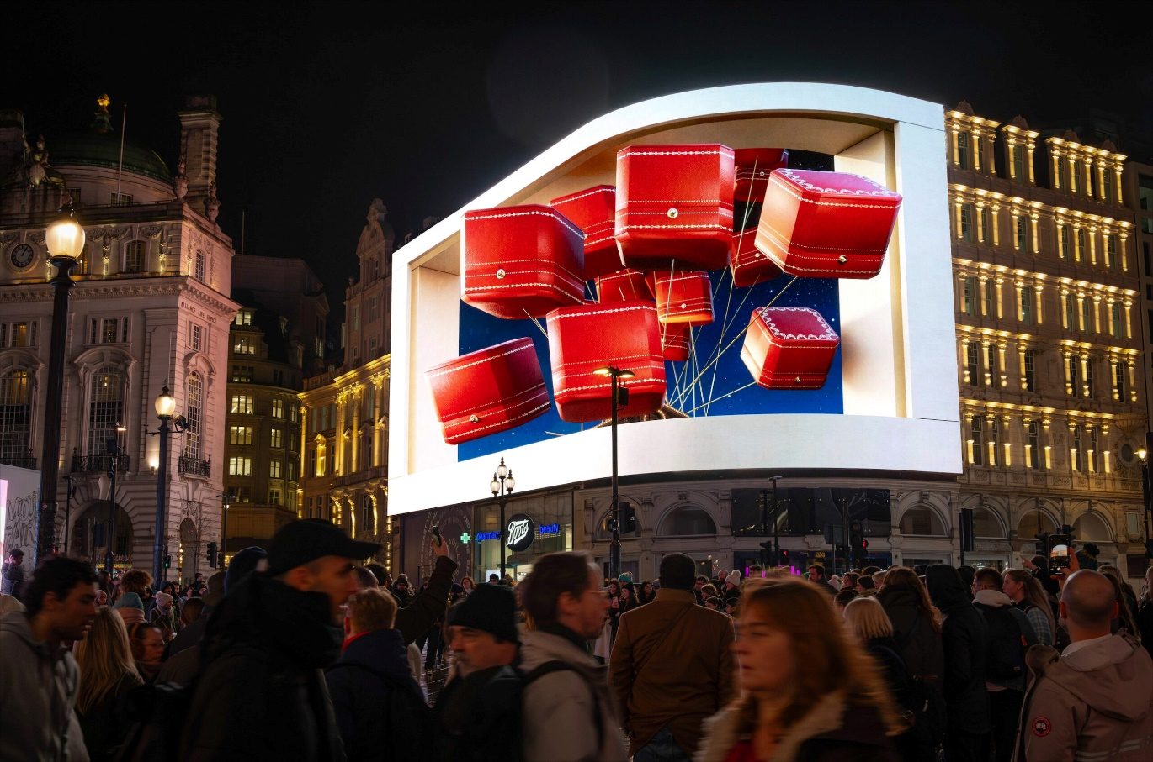
United 2025: Seize the Moment With Iconic Screens
Three Key Markets : Position your brand across strategic locations across the UK, USA, and UAE, reaching elite audiences in the world’s most influential regions
Programmatic Precision: Leverage Programmatic OOH with 2025 iconic screens, to deliver dynamic, data-driven campaigns
Perfect Timing: Engage elite audience starting the final week of December, welcoming 2025 with impact.
www.masscomglobal.com

Slide 6
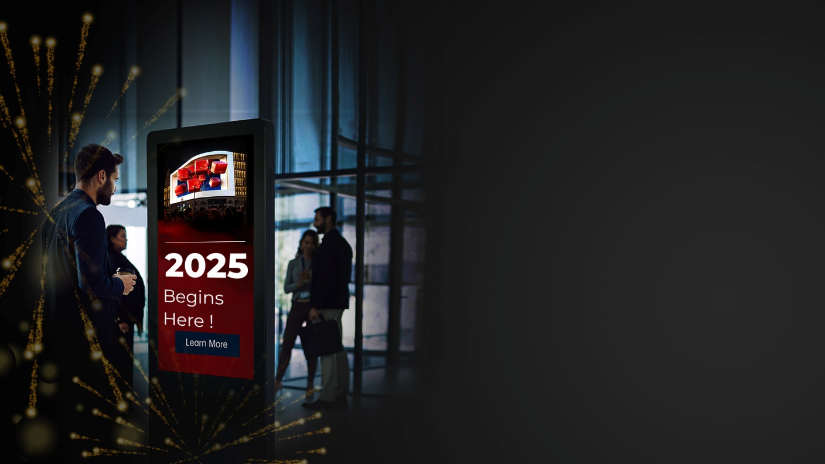
Save Your Time
We plan strategies aligned with your goals
Concept to execution, freeing you to focus on your business.
Gain Brand Value
Delivering 2,358,570 elite impressions weekly.
Peak-season visibility in UK, USA and UAE
Sustain long term brand impact
We simplify, you focus
Handpicked sites like Oxford Street and Dubai’s luxury malls.
Our partnership with Neuron’s PDOOH amplifies engagement.
www.masscomglobal.com

Slide 7
United Kingdom
www.masscomglobal.com

Slide 8
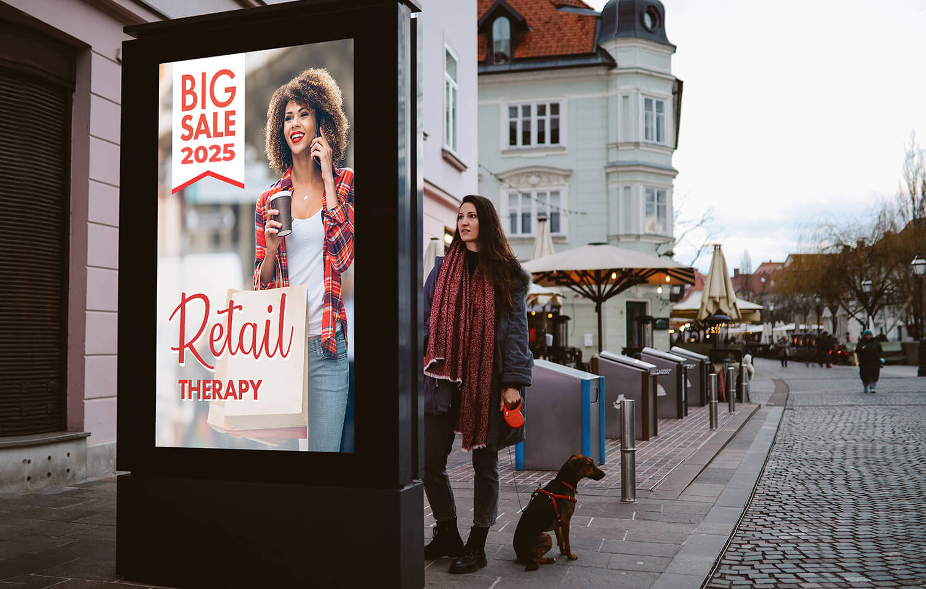
www.masscomglobal.com

Slide 9
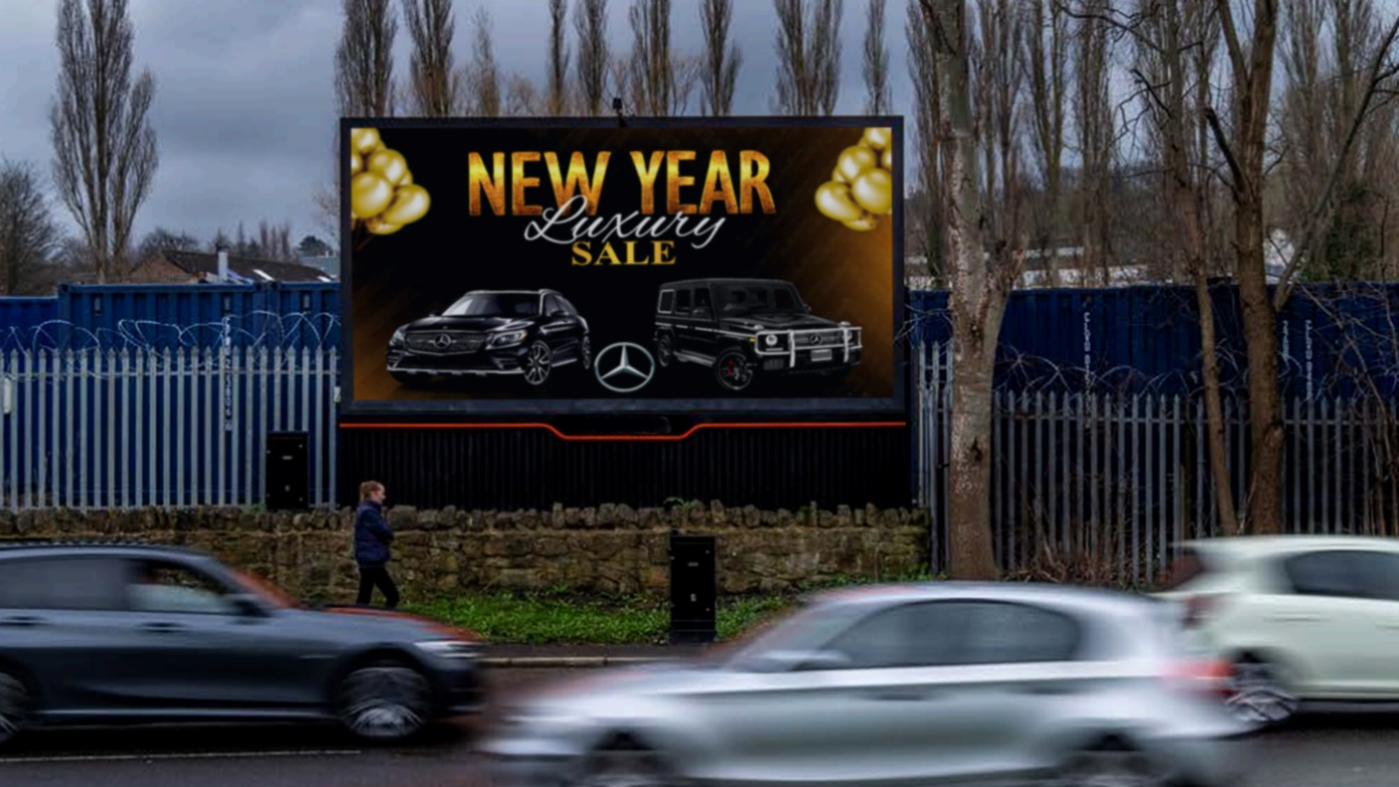
www.masscomglobal.com

Slide 10
United States of America
www.masscomglobal.com

Slide 11
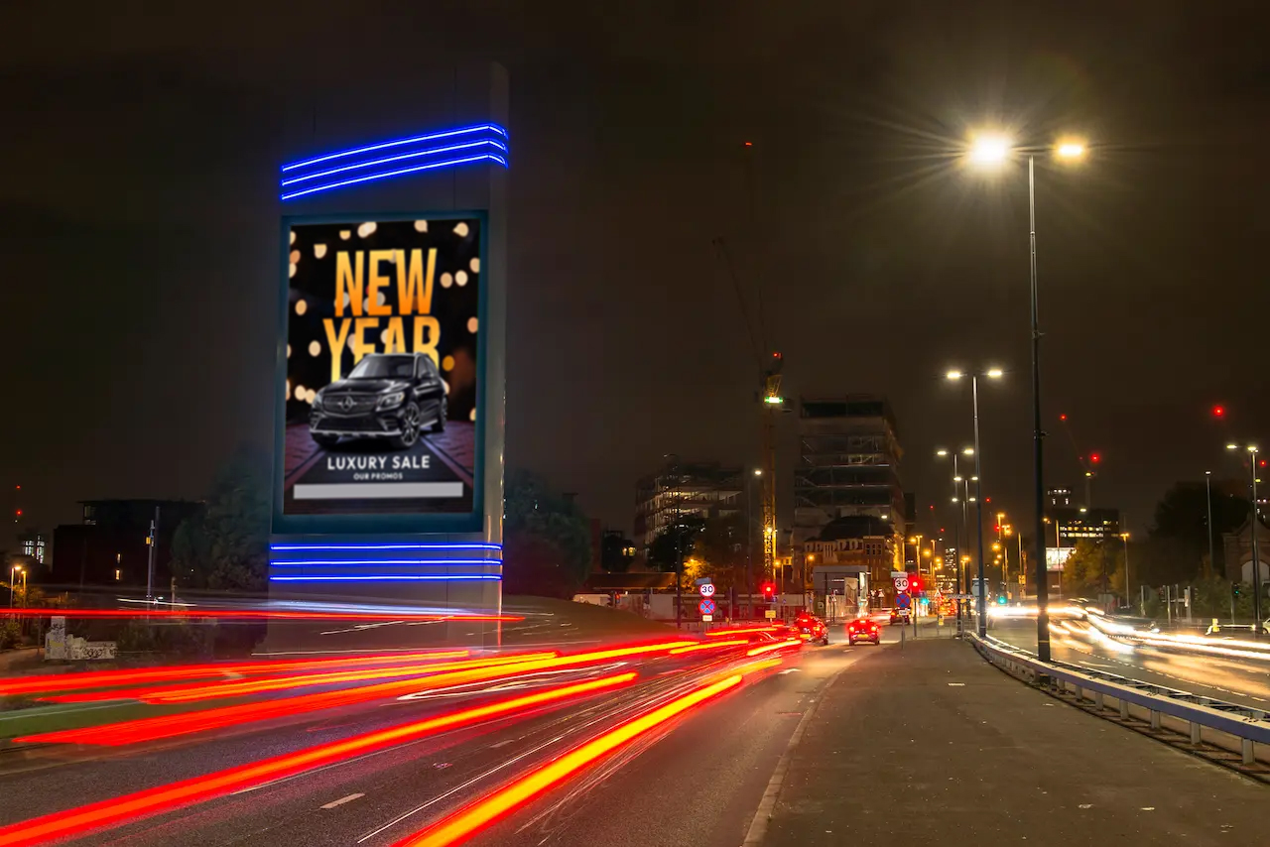
www.masscomglobal.com

Slide 12
www.masscomglobal.com

Slide 13
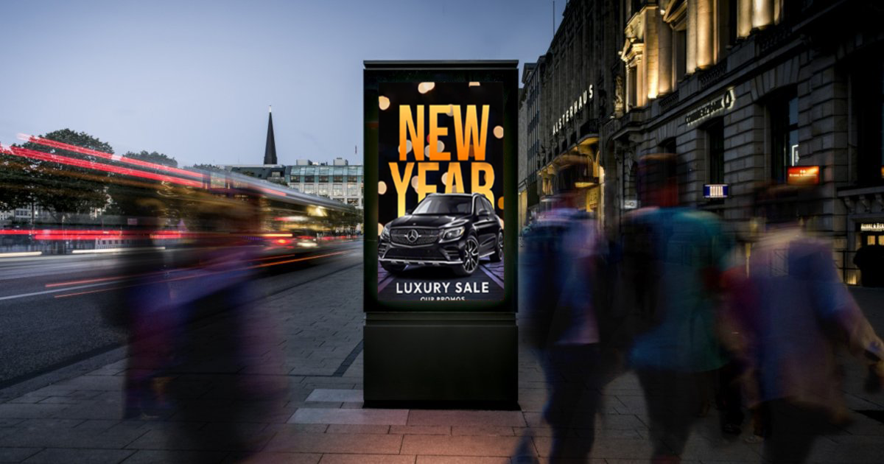
www.masscomglobal.com

Slide 14
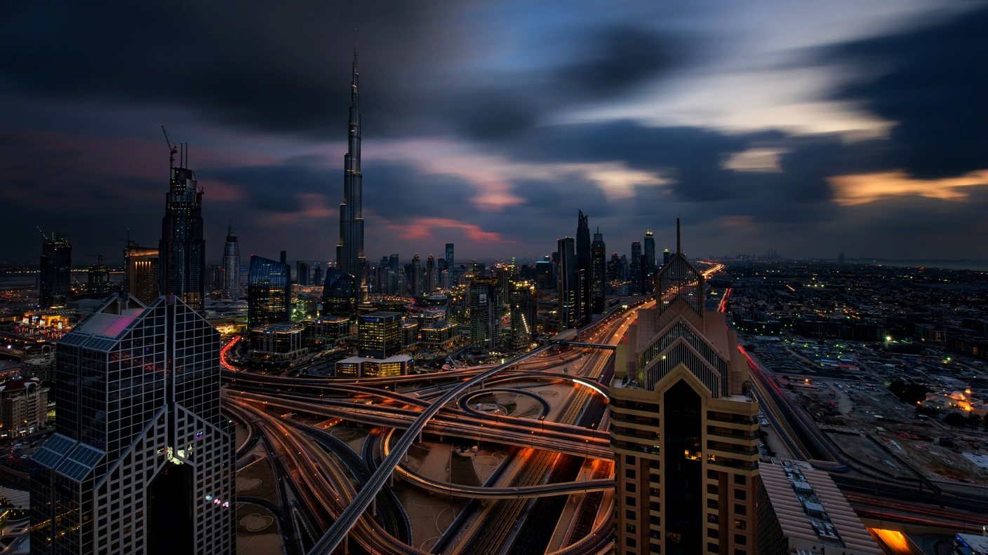
United Arab Emirates
www.masscomglobal.com

Slide 15
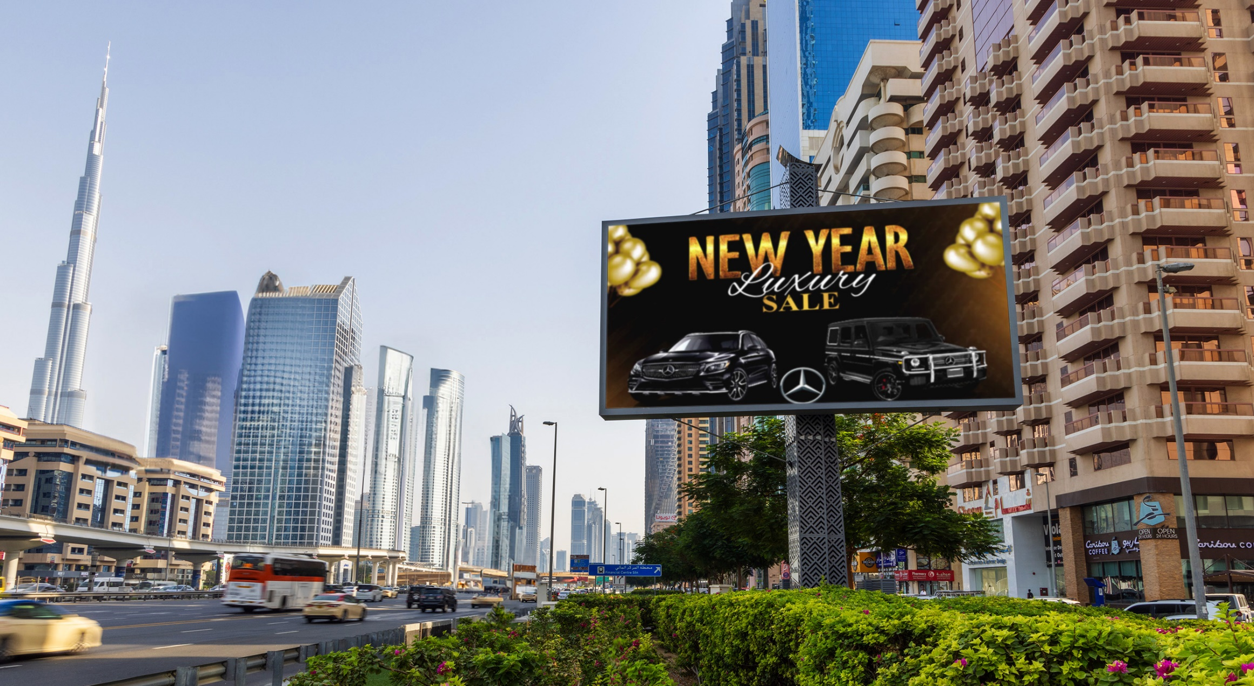
www.masscomglobal.com

Slide 16
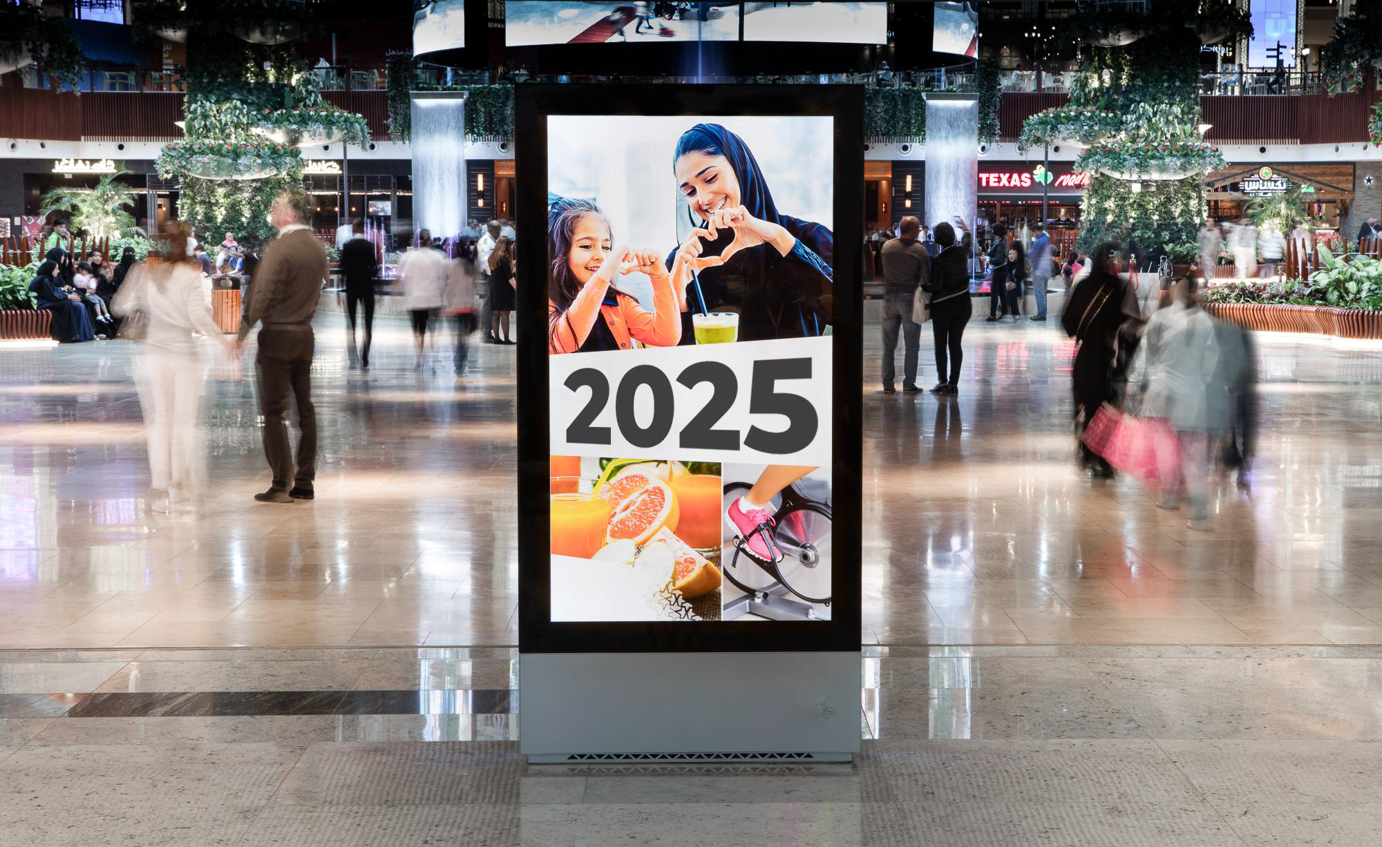
www.masscomglobal.com

Slide 17
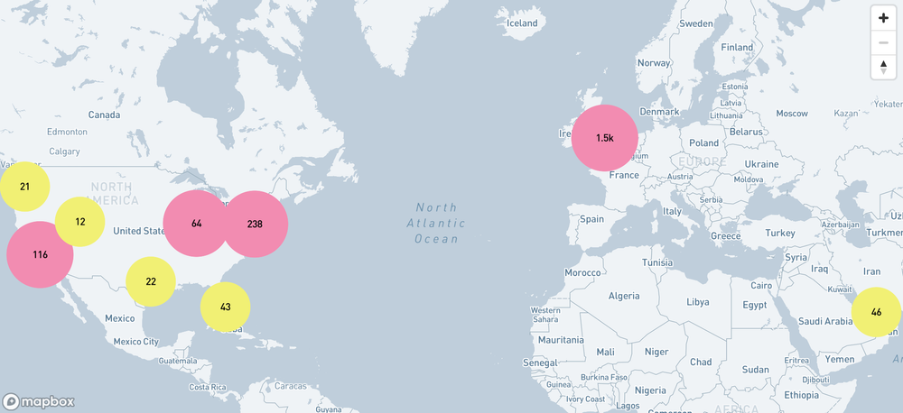
www.masscomglobal.com

Slide 18
Claim your free service of Real-Time Monitoring
Stay ahead with live insights and performance tracking throughout your campaign.
Your brand deserves to stand out.
We position you where the affluent connect and engage.
Seize this moment and elevate your brand to unparalleled heights.
Contact us today!
www.masscomglobal.com

Slide 19
THANK YOU
www.masscomglobal.com

