Slide 1
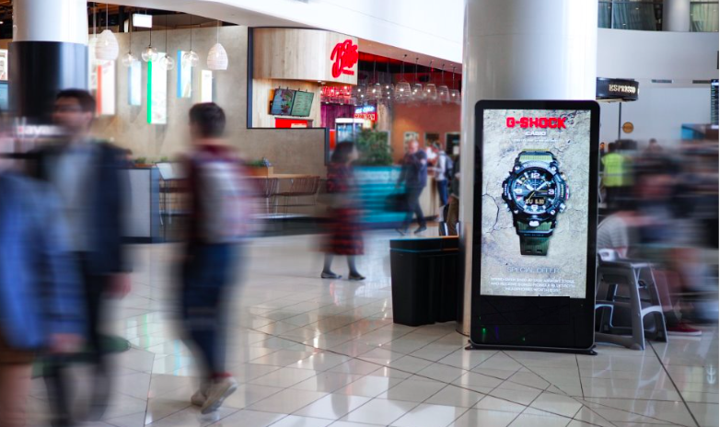
Auckland Airport
Newzealand

Slide 2
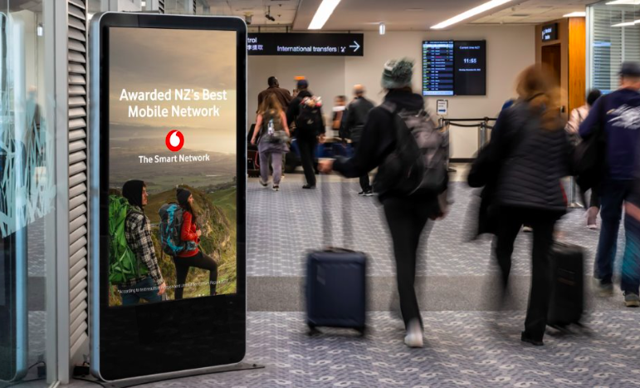
Location Name : 65" LCD Network - Arrivals - I38
Location Details
Arrivals, Digital Screen
0.81m x 1.43m

Slide 3
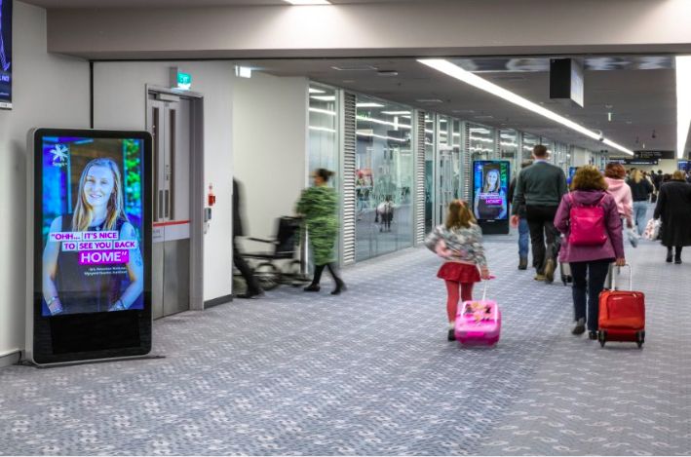
Location Name : 65" LCD Network - Arrivals - I36
Location Details
Arrivals, Digital screen
0.81m x 1.43m

Slide 4
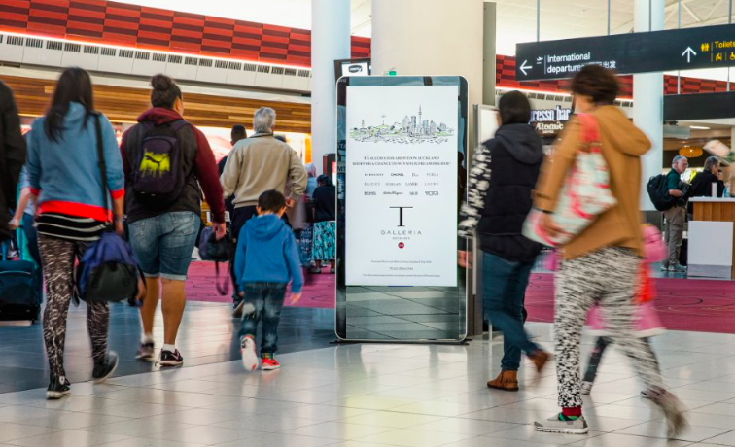
Location Name 65" LCD Network - Departures - I4
Location Details
Departures, Digital Screen
0.81m x 1.43m

Slide 5
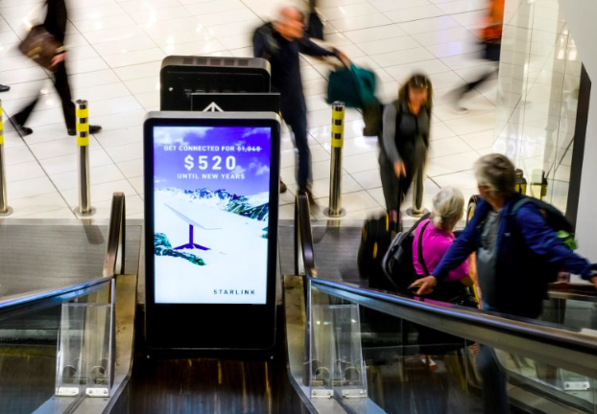
Location Name : 65" LCD Network - Departures - I6
Location Details
Departures, Digital Screen
0.81m x 1.43m

Slide 6
Thank You

