Slide 1
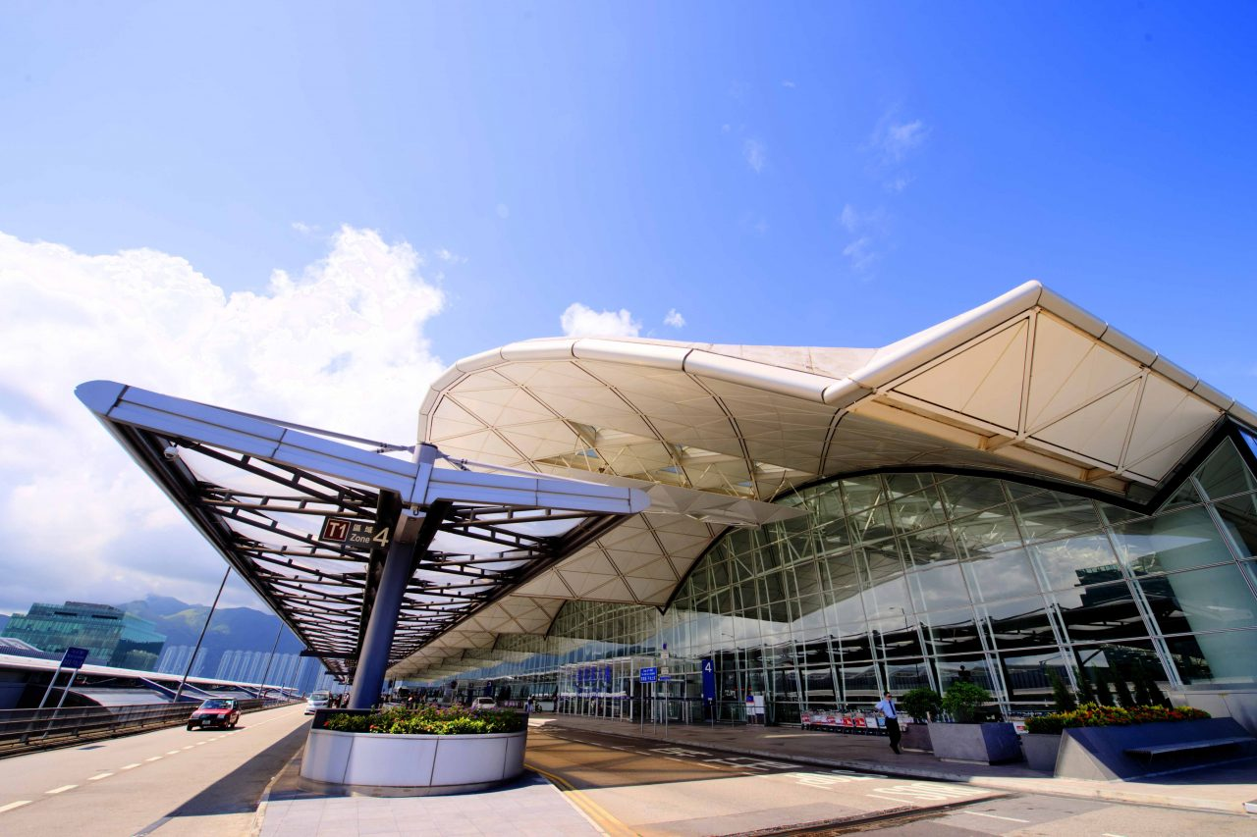
Hong Kong International
Airport

Slide 2
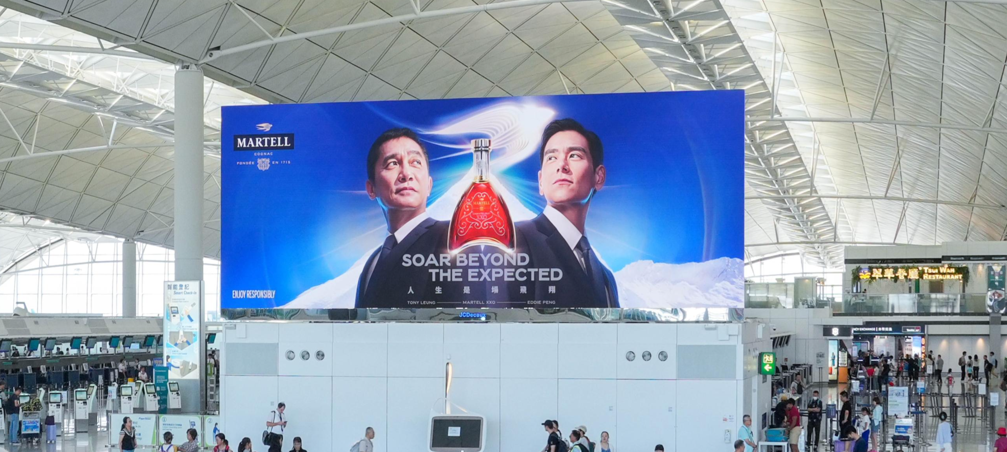
SPECTACULAR CHECK-IN DIGITAL
Location details
Departures & Arrivals
Terminal 1, level 7,
check-in hall
Spec
2x Digital panels
2x | W 13,800mm x H 5,062mm

Slide 3
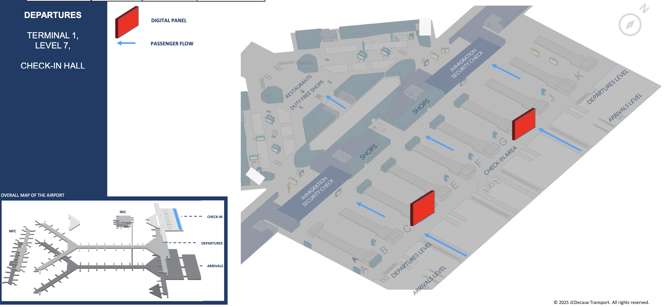
Map View

Slide 4
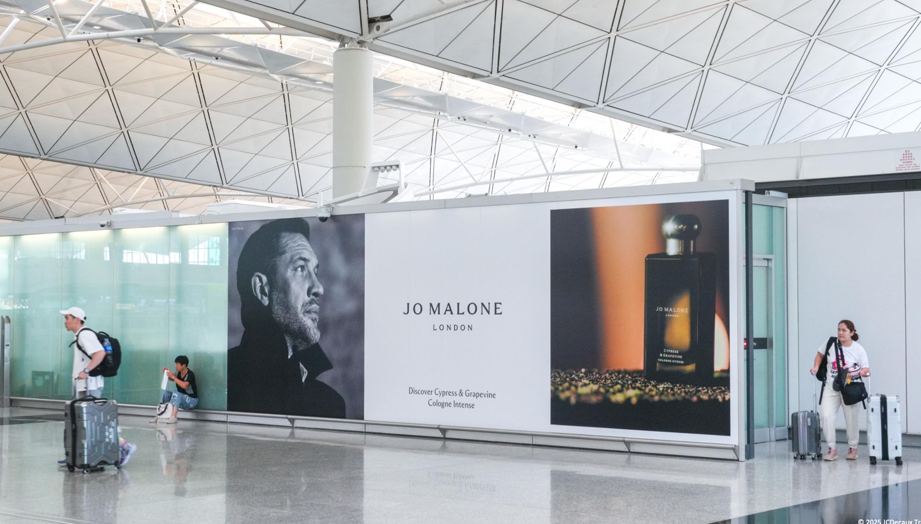
DEPARTURES PRE-IMMIGRATION
LIGHTBOXES & POW
Location details
Departures & Arrivals
Terminal 1, Level 7,
Check-in Hall
Spec
2x | W 13,800mm x H 5,062mm

Slide 5
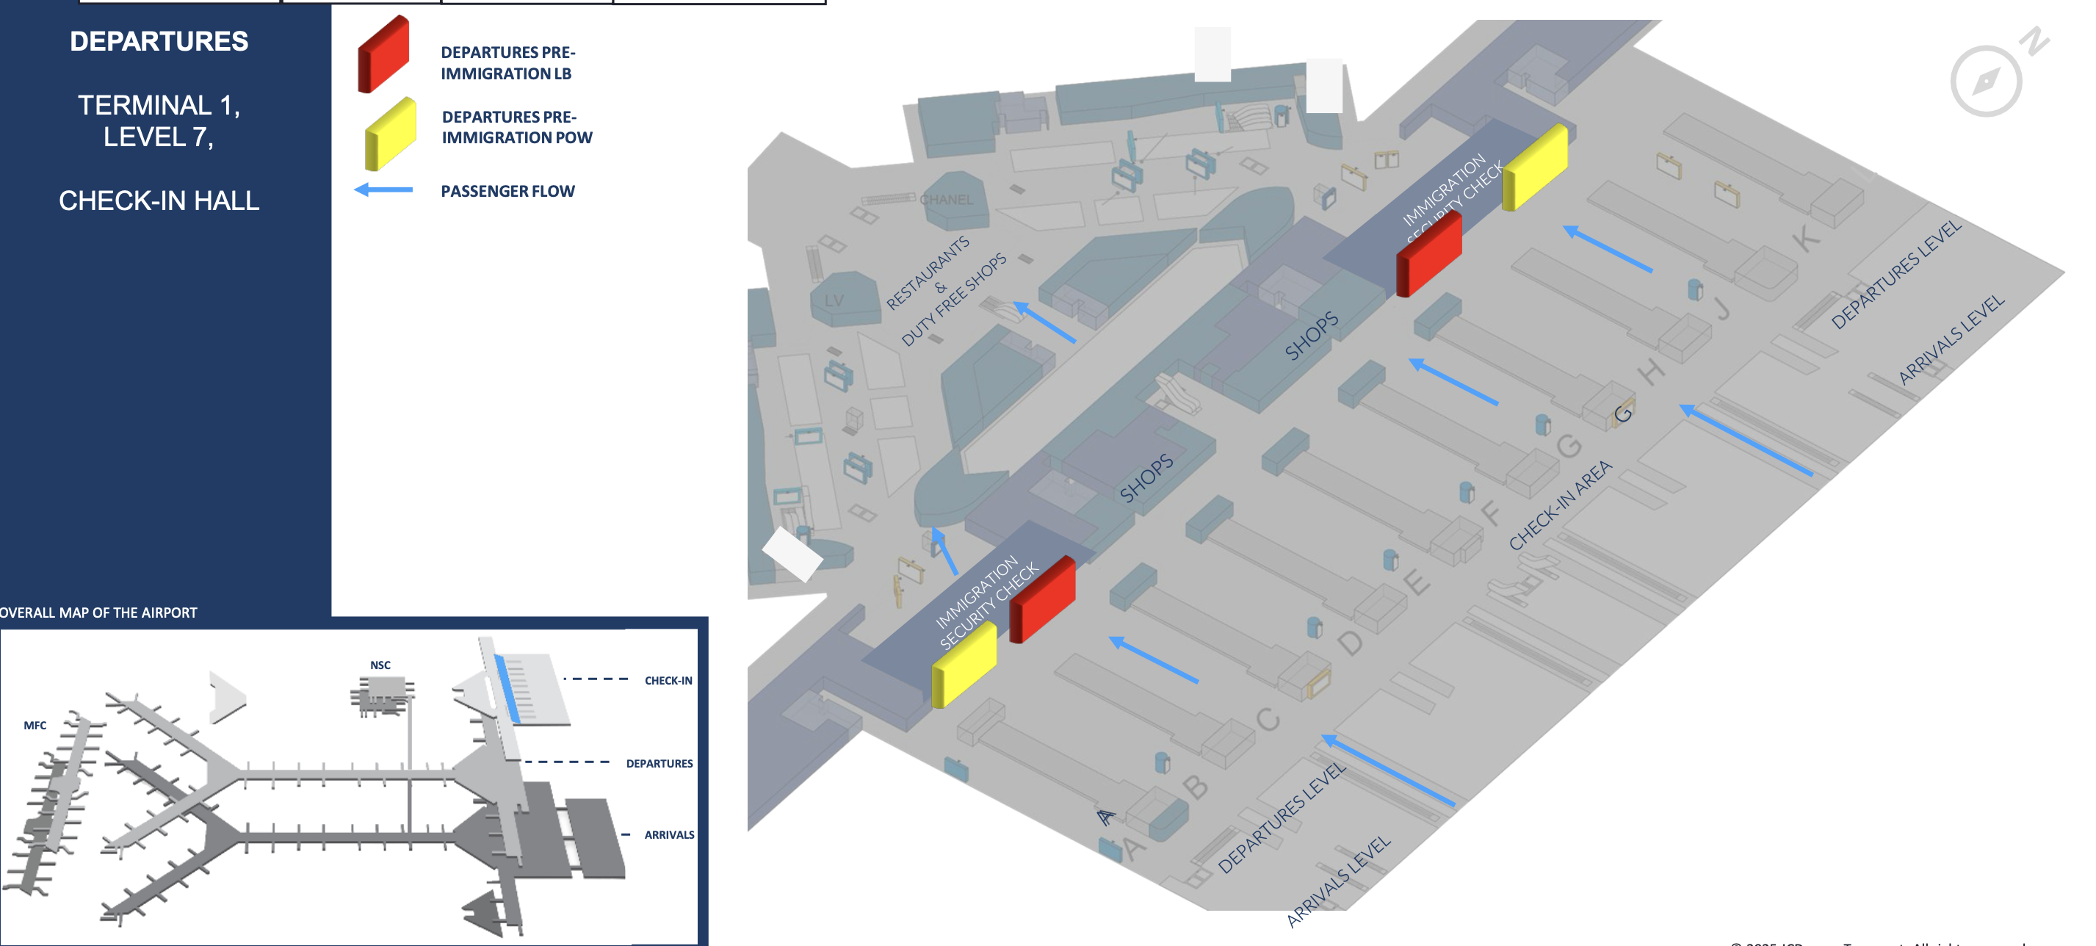
Map View

Slide 6
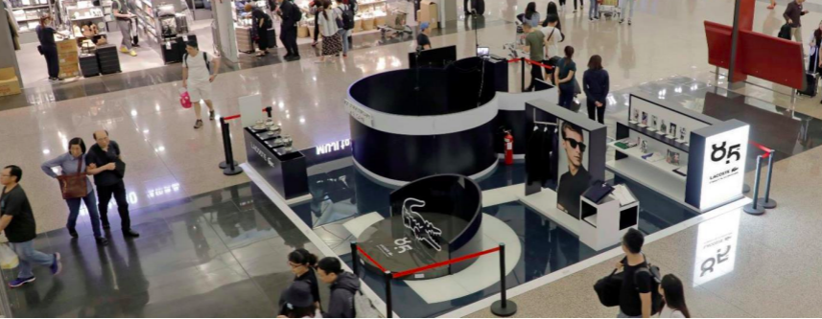
Departure, Check-in Hall
Location details
Departures, Terminal 1, Level 6, Check-in Hall
Spec
Experiential Site: 1x | 36 sqm | Max Height: 1.9m
Banners: 2x | W2500mm x H5500mm

Slide 7
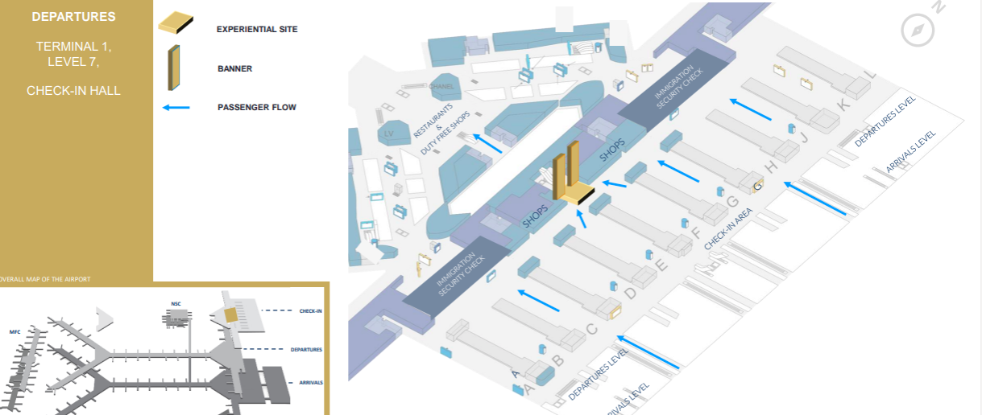
Map View

Slide 8
Departure , Duty- Free Area
Location details
Departures, Terminal 1, Level 6, Duty-Free Area
Spec
Front Panels: 2x | W4800mm x H2160mm
Side Panels: 2x | W3840mm x H2160mm

Slide 9
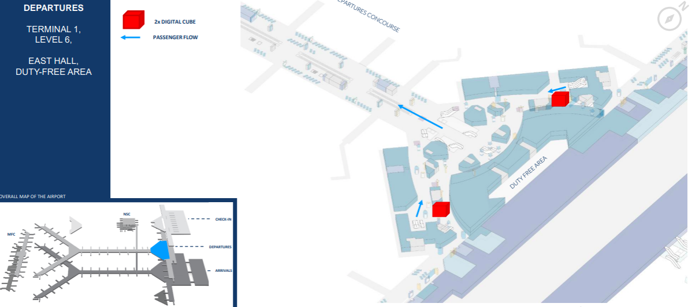
Map View

Slide 10
Map View
Thank You

