Slide 1
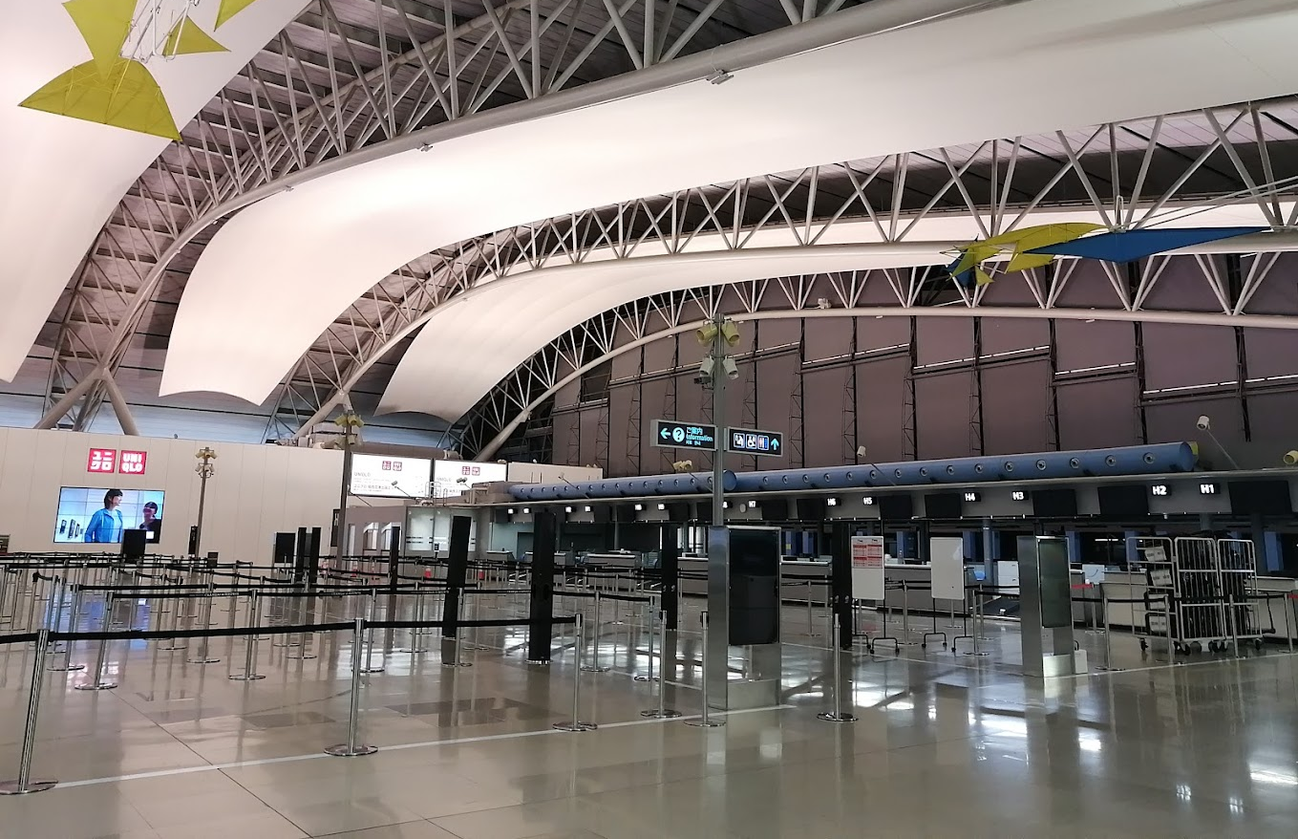
Kansai International Airport Osaka , Japan

Slide 2
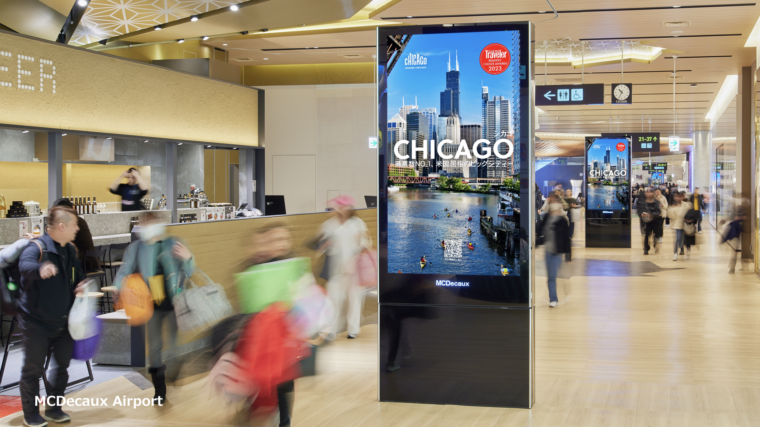
International Departures Digital Network
Location details
Departure Air side & Land side. Strategically located to cover all the busiest areas, this network reaches 100% of the audience (passengers as well as meters & greeters) at KIX Kansai International Airport’s international departures.
Spec
24 LCD Portrait screens. 84" | 80' | 75" Rate
59,522 $ for 1 Month

Slide 3
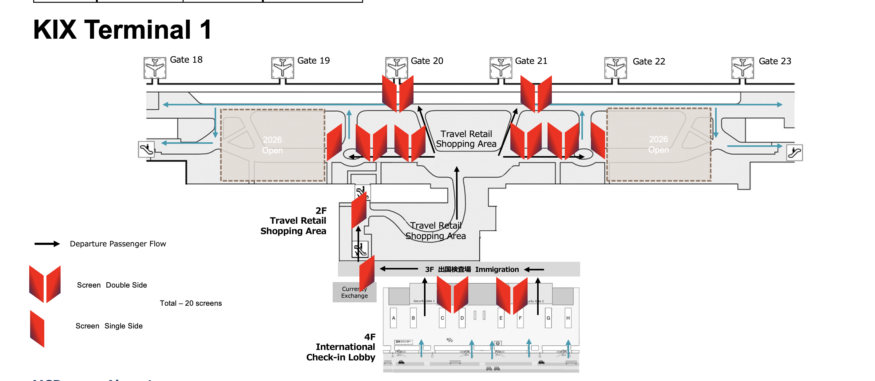
Map View

Slide 4
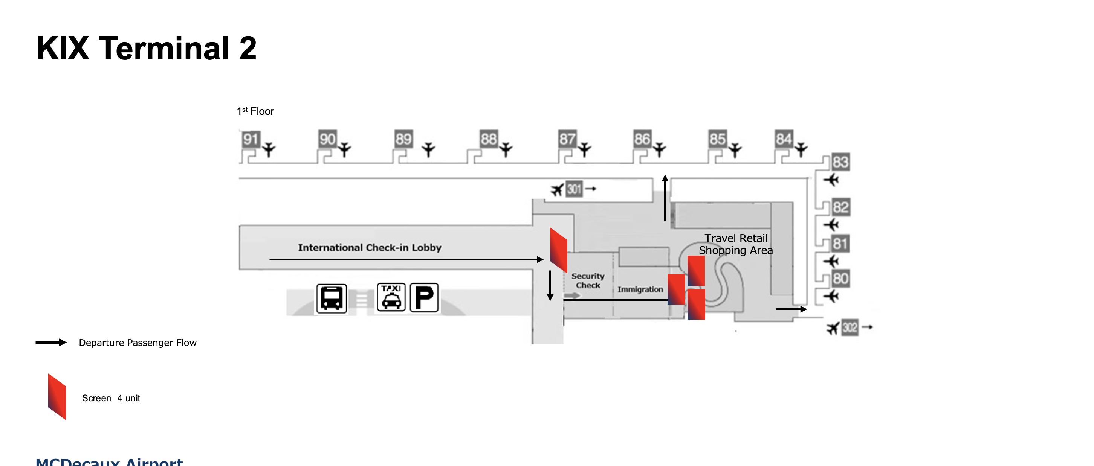
Map View

Slide 5
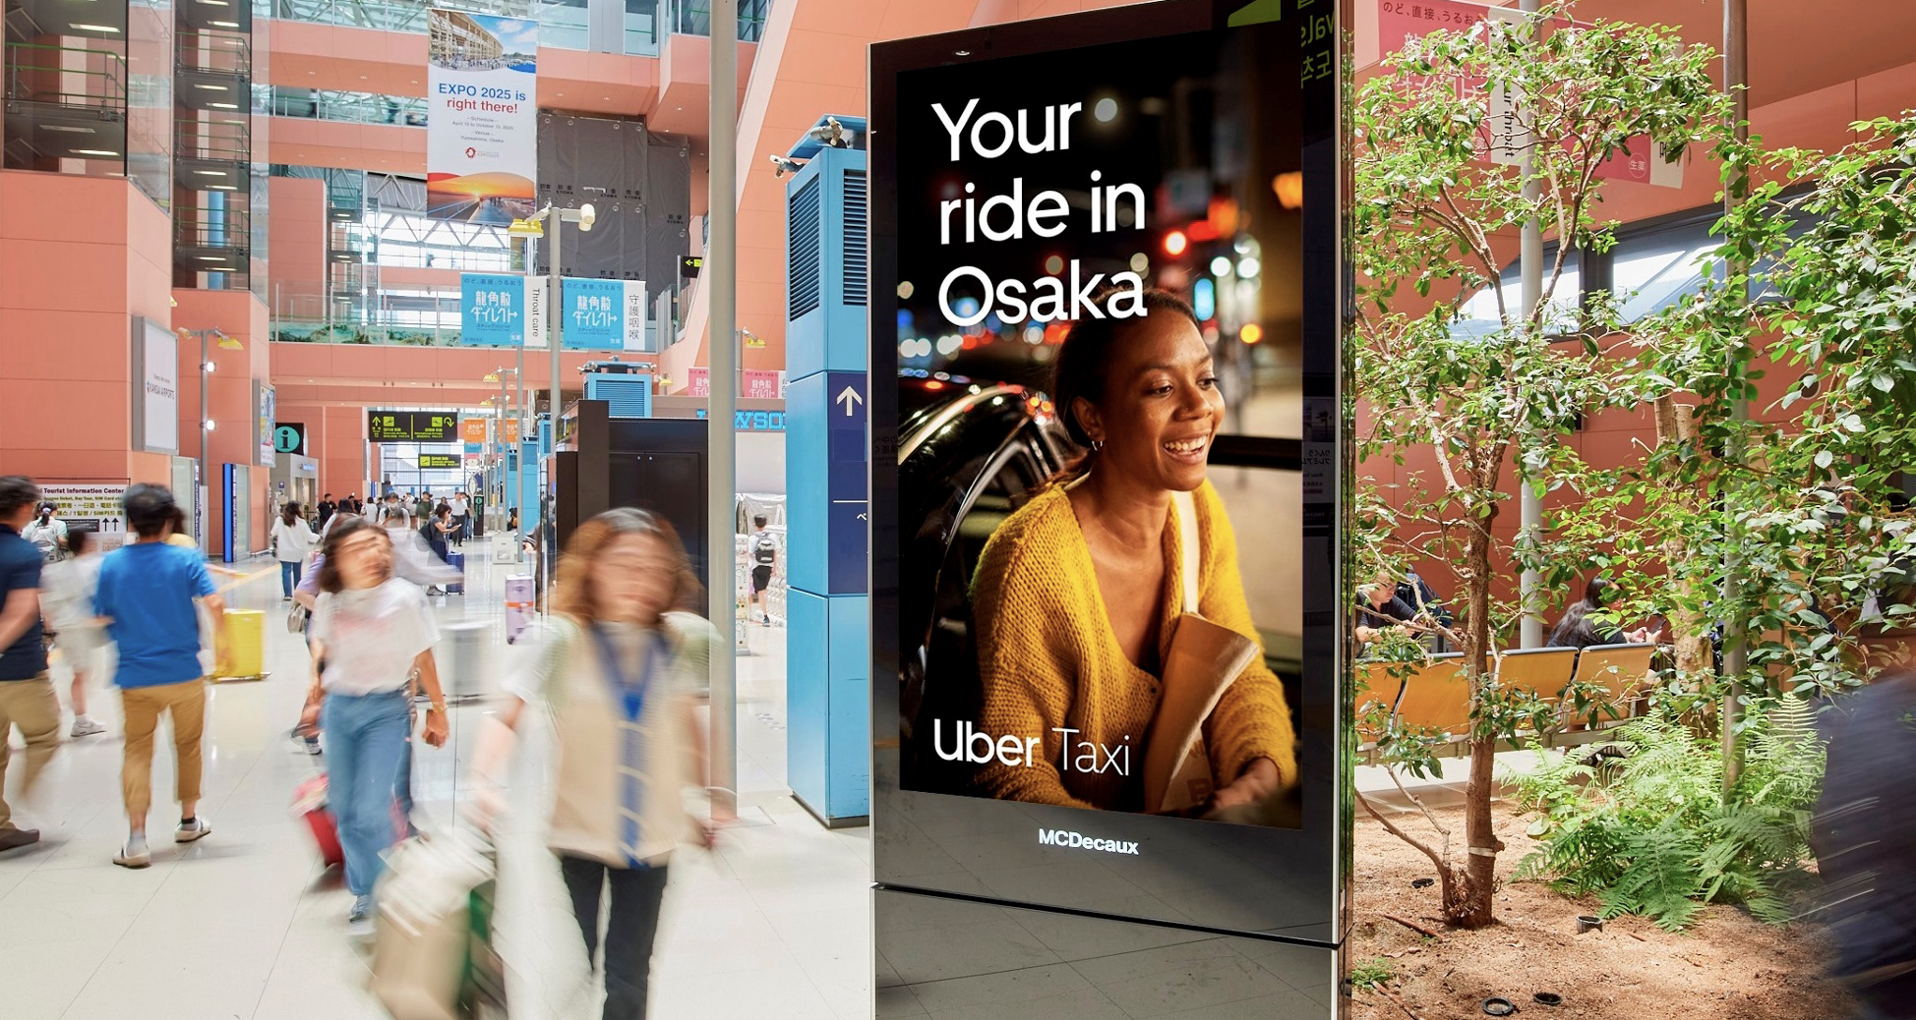
International Arrivals digital Network
Location details
Arrivals airside & landside.
Strategically located to cover all the busiest areas, this network reaches 100% of the audience (passengers as well as meters & greeters) at KIX international arrivals.
Spec
9 LCD Portrait screens. 85" | 75"
Rate
36,580 $ for 1 month

Slide 6
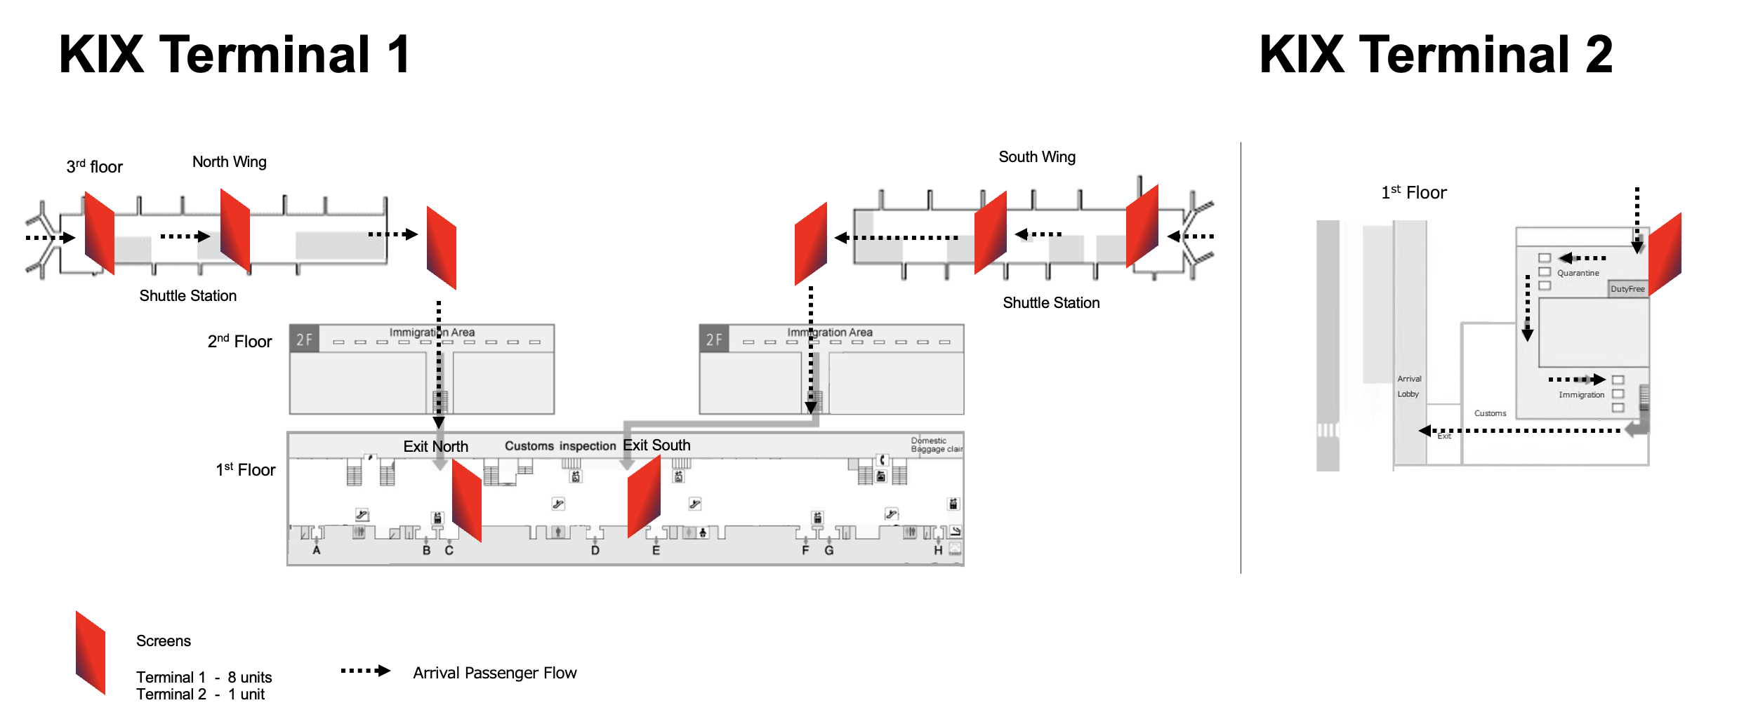
Map View

Slide 7
Thank You

