Slide 1
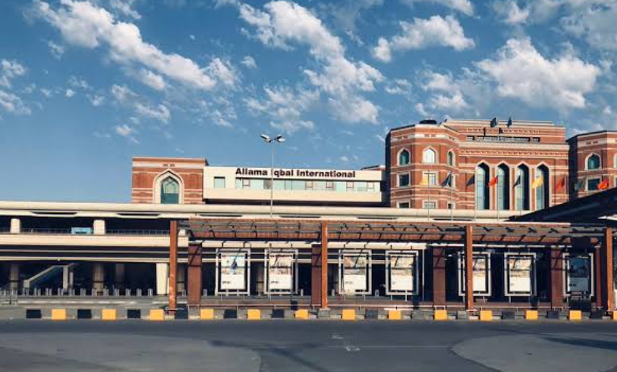
Allama Iqbal International
Airport, Lahore, Pakistan

Slide 2
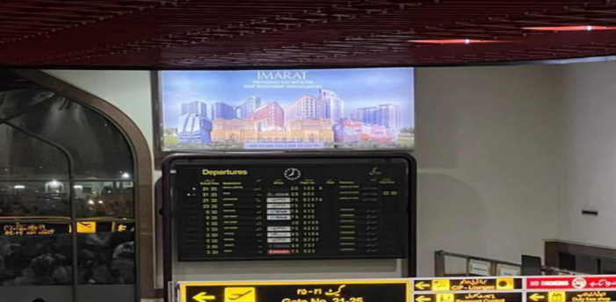
International Departure Hall
Spec
Type: Backlit Size: 16x8

Slide 3
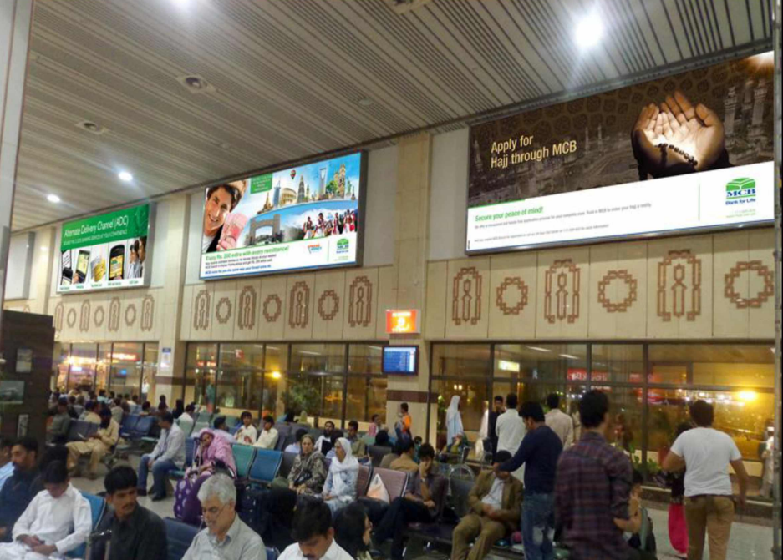
International Departure Hall
Spec
Type: Backlit Size: 24x10

Slide 4
Thank You

