Slide 1
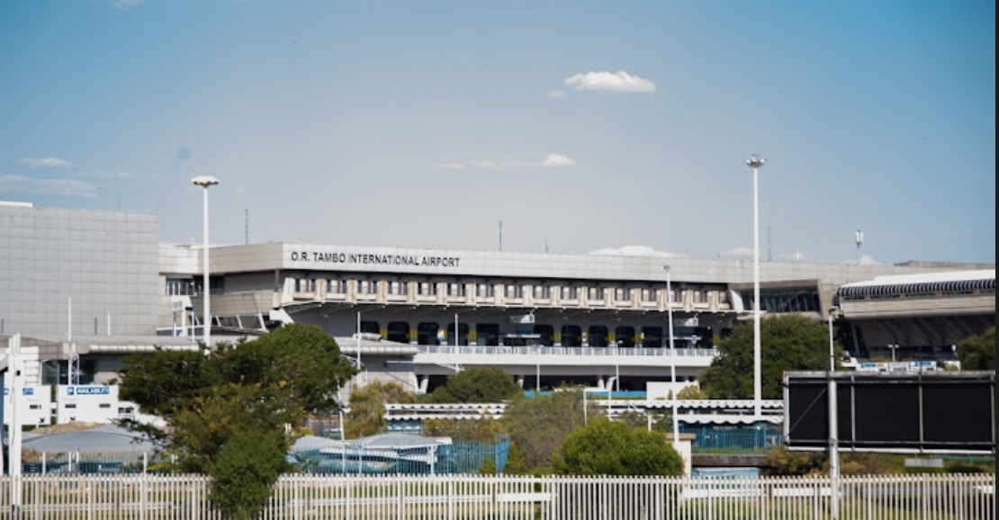
OR Tambo International Airport, Johannesburg, South Africa.

Slide 2
International Departures
Location details
High impact site bulkhead, opposite the 'Big 5' duty free shop, visible to all passengers at passport control and duty-free area
igh impact site bulkhead, opposite the 'Big 5' duty free shop, visible to all passengers at passport control and duty-free area
Spec
Product Type : Bulkhead
Panels: 3
Illuminated : No
Size : 73 Sqm

Slide 3
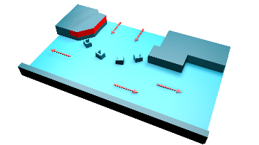
Map View
Passport Control
International
Departures

Slide 4
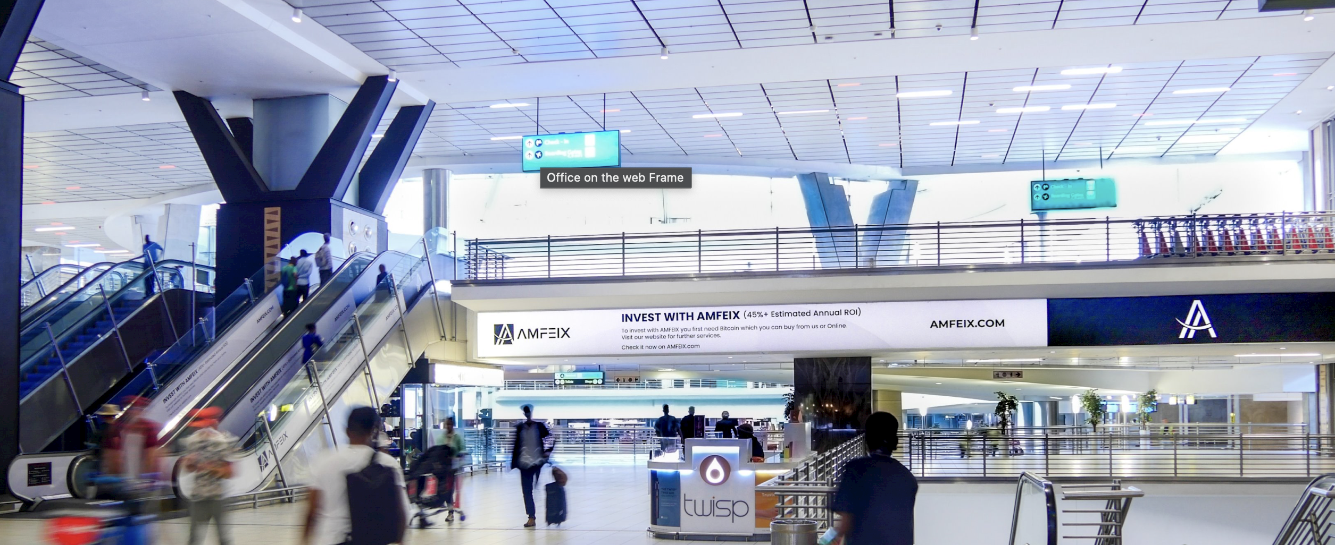
International Departures
Location details
Located public concourse, targeting all domestic and international travellers & 'meeters and greeters', in proximity to airport door entrances, elevators and escalators.
Spec
Product Type : Zone
Panels: Multiple
Illuminated : No
Size : 73 Sqm 1 x 20m (bul-head)

Slide 5
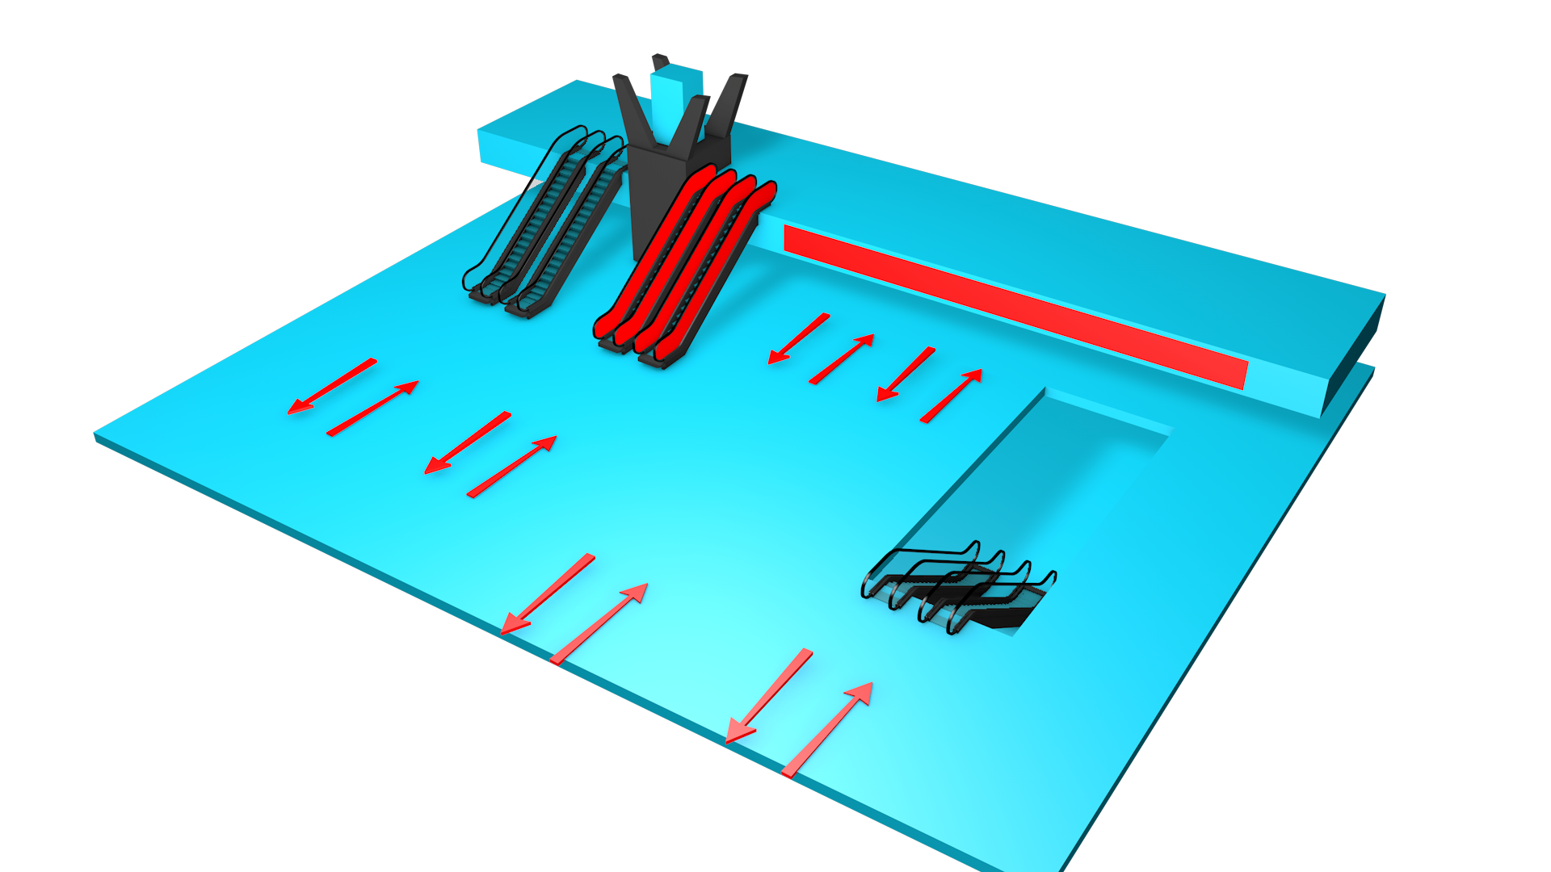
Map View
Public Concourse
International Departures

Slide 6
International Departures
Location details
Targeting passengers prior to boarding at boarding gate 3
Spec
Product Type : Wall Site
Panels: 2
Illuminated : No

Slide 7
Domestic Arrivals
Location details
High impact wall site, targeting all domestic arrival passengers, on route to the baggage hall coming, from the buses from plane
Spec
Product Type : Wall Site
Panels: 2
Illuminated : No
Size: 54.45 Sqm 2.8 x8.9m & 1.92 x16.21m

Slide 8
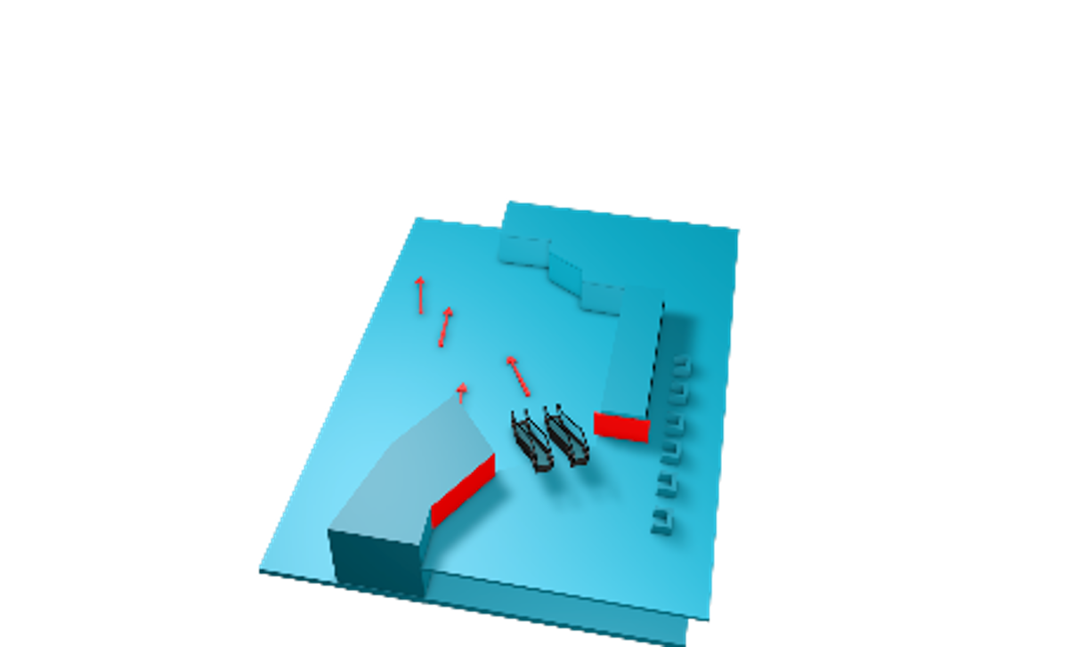
Map View
Baggage Claim
Domestic Arrivals
Bus Drop Off Point

Slide 9
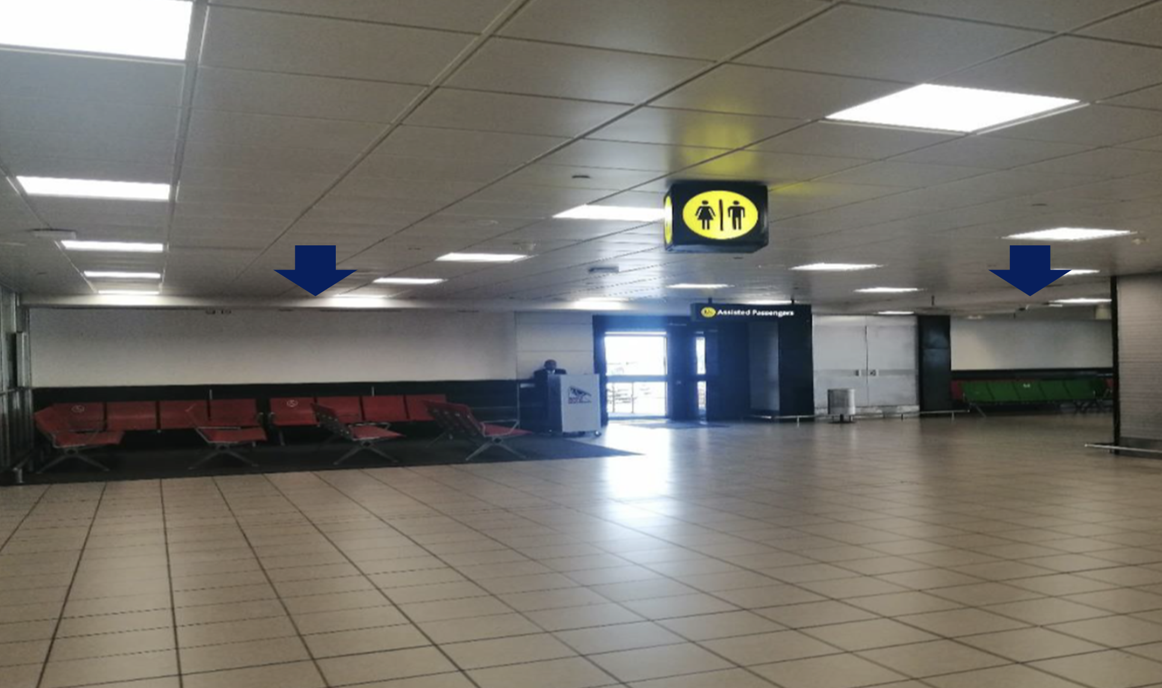
Domestic Departures
Location details
Airside – Departure Gates E Hall.
Spec
Product Type : Wall Site
Panels: 3
Illuminated : No

Slide 10
External Site
Location details
Entrance from Johannesburg to OR Tambo International Airport | Johannesburg International Airport | Gauteng
Spec
Size: 6X12
Illumination: No

Slide 11
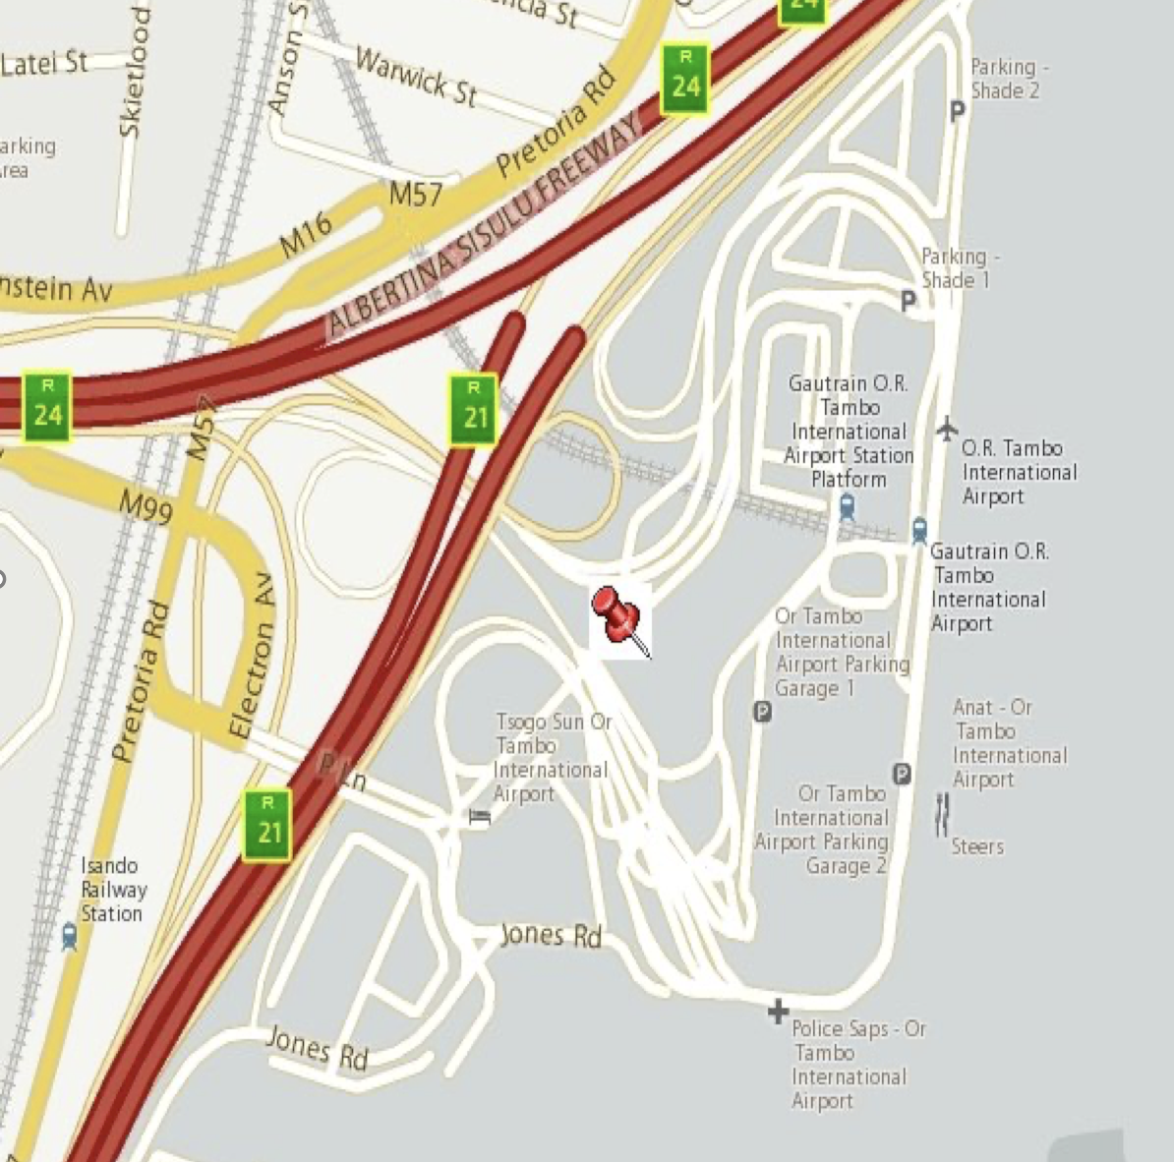
Map View
6X12​

Slide 12
Thank You

