Slide 1
Own the Spotlight at Paris with pDOOH this Fashion Week
January 21-26
Men’s Fashion Week

Slide 2
Why
programmatic DOOH for Paris Men’s Fashion Week campaign targeting Elite Brands, fashion celebrities and decision makers?
Benefits
of programmatic DOOH
Programmatic Advertising: Tailor your digital out-of-home (DOOH) campaigns with precision, targeting high-traffic areas near convention centres in real-time
Culturally Smart and Data-Driven: Seamlessly integrate diverse datasets to deliver content that resonates with the elite brands, affluent audience & celebrity community at the right moment.
Dynamic Campaign Activation: Data feeds initiate context-aware displays based on busy times, fashion events, and cultural celebrations, enhancing relevance and engagement.
Flexibility, Speed, and Modularity
Quick Campaign Setup
Dynamic Campaign Management
Unlike traditional methods, it enables real-time adaptation to external conditions and personalized ad delivery.
Benefits include increased efficiency, precise audience targeting, and improved ROI.

Slide 3
Advantages
Dynamic Audience Targeting
Trigger Targeting
P-DOOH analyzes location data, creating audiences from consumer movements for targeted ads.
Optimize messaging for weather's impact on consumer behavior in real-time.
Live Data-Led Dynamic Creative
Live Data Feeds
Customize creative in real-time based on all types of local data
Weather, traffic, flight data.
Local data sets for targeting e.g. demographic postcode data

Slide 5
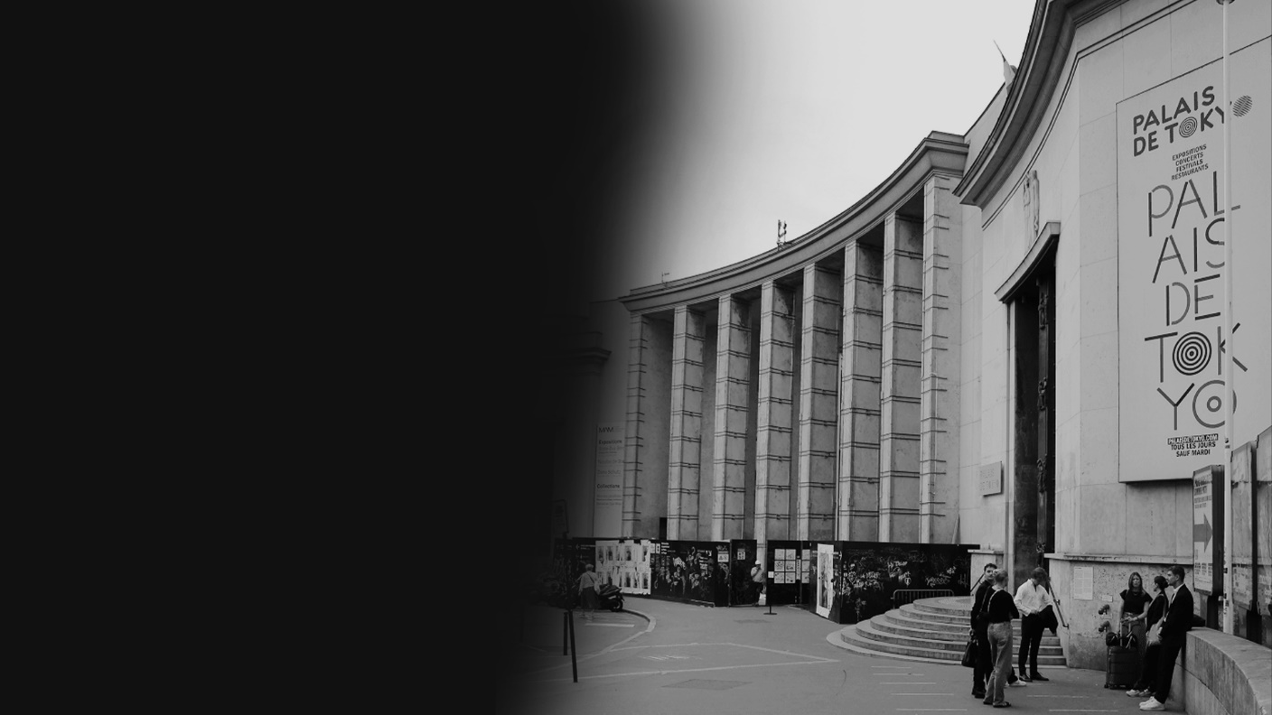
Palais de Tokyo - Paris

Slide 6
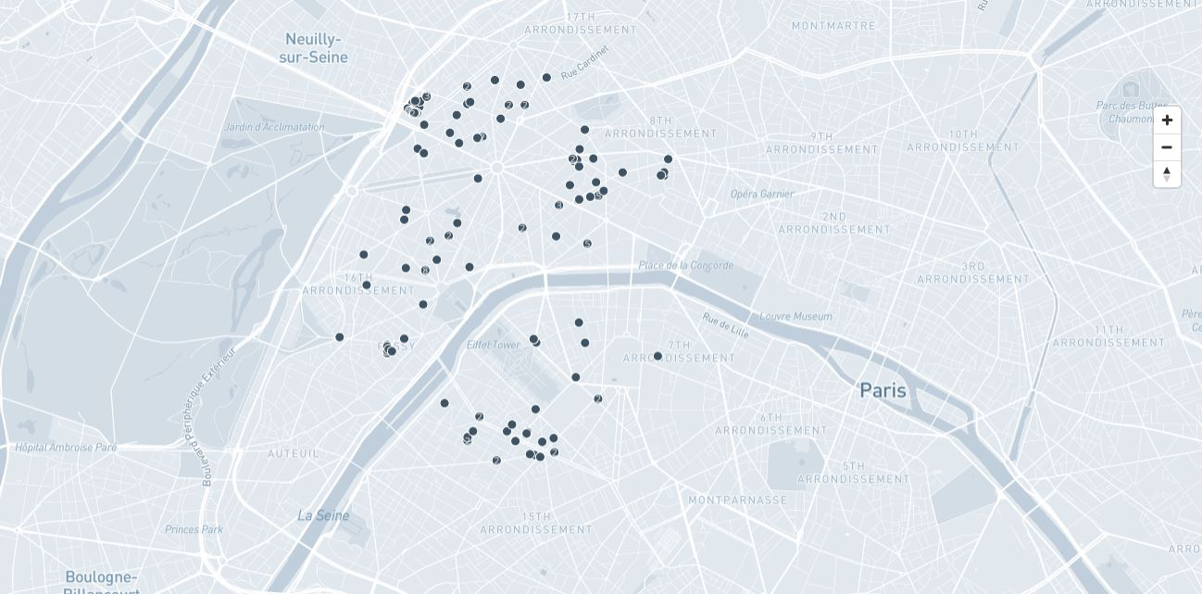
P – DOOH – France, Palais de Tokoyo recommendation Map View

Slide 7
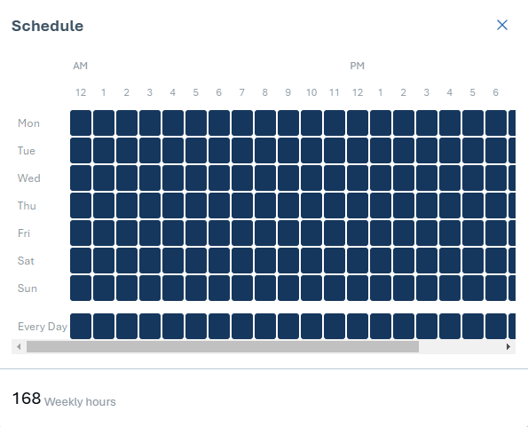
P – DOOH – Scheduled Time
No of screen :155

Slide 8
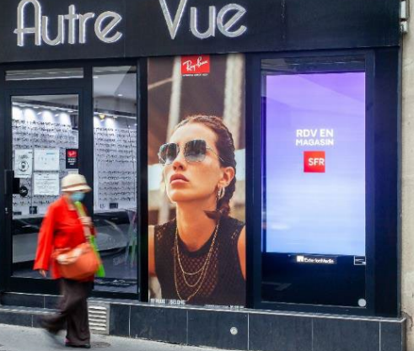
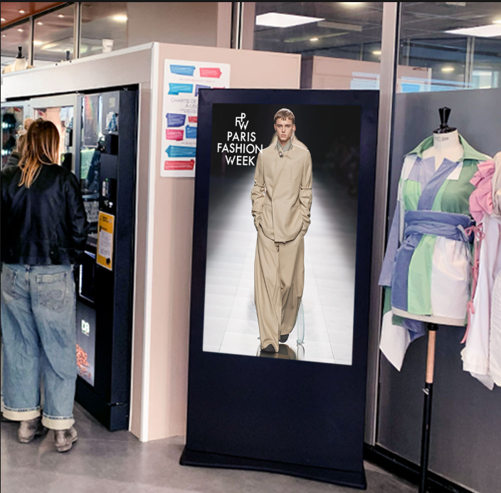
P – DOOH – France, Palais de Tokoyo recommended Sites
No of screen :155

Slide 9
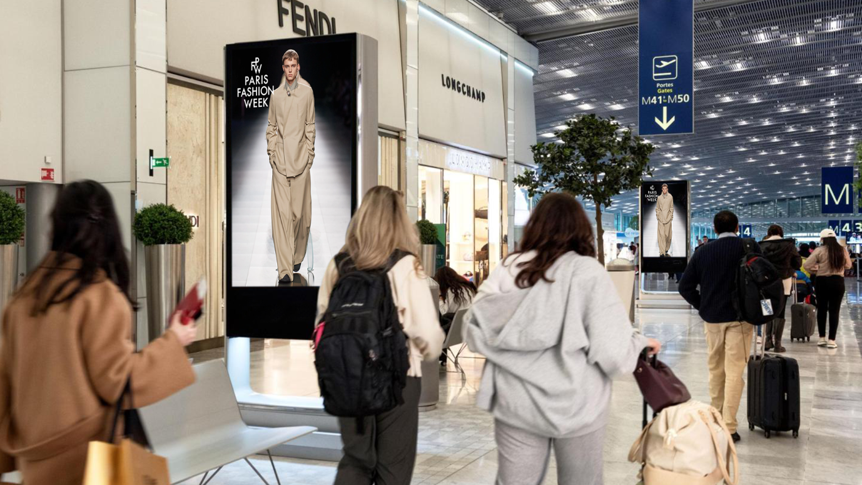
P – DOOH – France, Palais de Tokoyo recommended Sites
No of screen :155

Slide 10
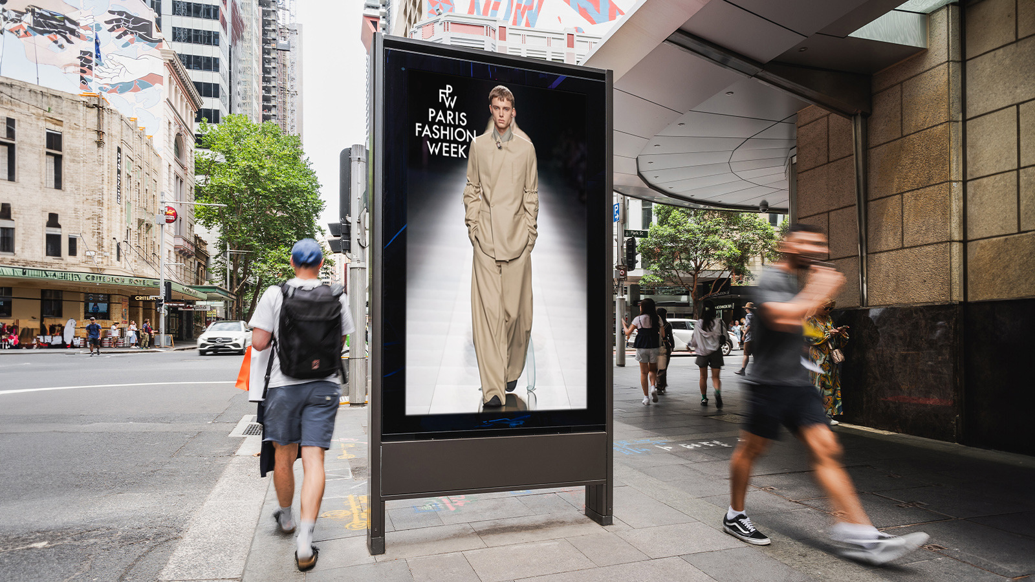
P – DOOH – France, Palais de Tokoyo recommended Sites
No of screen :155

