Slide 1
LIST OF INFLUENCERS

Slide 2
NAME:
Ravi Kewal Ramani INSTAGRAM: @rk.ravikewalramani
FOLLOWERS COUNT: 1.3M
DELIVERABLES: 1 Reel and 2 stories
CATEGORY : REAL ESTATE

Slide 3
NAME: Viraj Ghelani INSTAGRAM: @viraj_Ghelani
FOLLOWERS COUNT: 1.3M
DELIVERABLES: 1 Reel and 2 stories
CATEGORY : Comedy, Entertainment, and Lifestyle.

Slide 4
NAME:
Ca Palakrathi INSTAGRAM: @ca.palakrathii
FOLLOWERS COUNT: 531k
DELIVERABLES: 1 Reel and 2 stories
CATEGORY : FINANCE

Slide 5
NAME:
Simran Gupta INSTAGRAM: @code.estate
FOLLOWERS COUNT: 252k
DELIVERABLES: 1 Reel and 2 stories
CATEGORY : Real estate

Slide 6
NAME: Mansi Rajani INSTAGRAM: @mansirajani85
FOLLOWERS COUNT: 471k
DELIVERABLES: 1 Reel and 2 stories
content creator specializing in motherhood, lifestyle, fashion, beauty, and skincare. She has been recognized as one of the "Top 10 Influencers" by Outlook India.

Slide 7
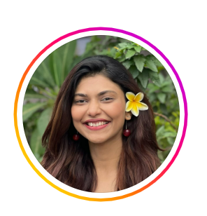
NAME: Shreya Jaiswal INSTAGRAM: @the_unconventional_ca
FOLLOWERS COUNT: 314k
DELIVERABLES: 1 Reel and 2 stories
Chartered Accountant who creates content focused on finance and business education. She describes herself as a CA, creator, speaker, and entrepreneur, aiming to make finance and business concepts accessible to a broad audience. Her content includes educational posts, podcasts, and discussions on various financial topics.

Slide 8
NAME: Aman Lakhwani INSTAGRAM: @aman_lakhwani_
FOLLOWERS COUNT: 140k
DELIVERABLES: 1 Reel and 2 stories
CATEGORY : Finance

Slide 9
NAME: Yash Tala INSTAGRAM: @yashtala
FOLLOWERS COUNT: 56k
DELIVERABLES: 1 Reel and 2 stories
Category :Comedy, Entertainment, and Lifestyle

Slide 10
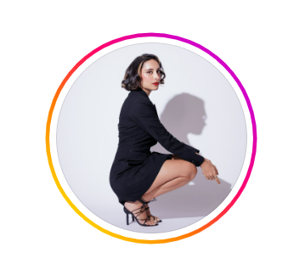
NAME: Amritha Takur INSTAGRAM: @amrita_thakur
FOLLOWERS COUNT: 1.3M
DELIVERABLES: 1 Reel and 2 stories
Category : Lifestyle

Slide 11
NAME: Simon Khambatta INSTAGRAM: @simone.khambatta
FOLLOWERS COUNT: 216k
DELIVERABLES: 1 Reel and 2 stories
Category : Lifestyle

