Slide 1
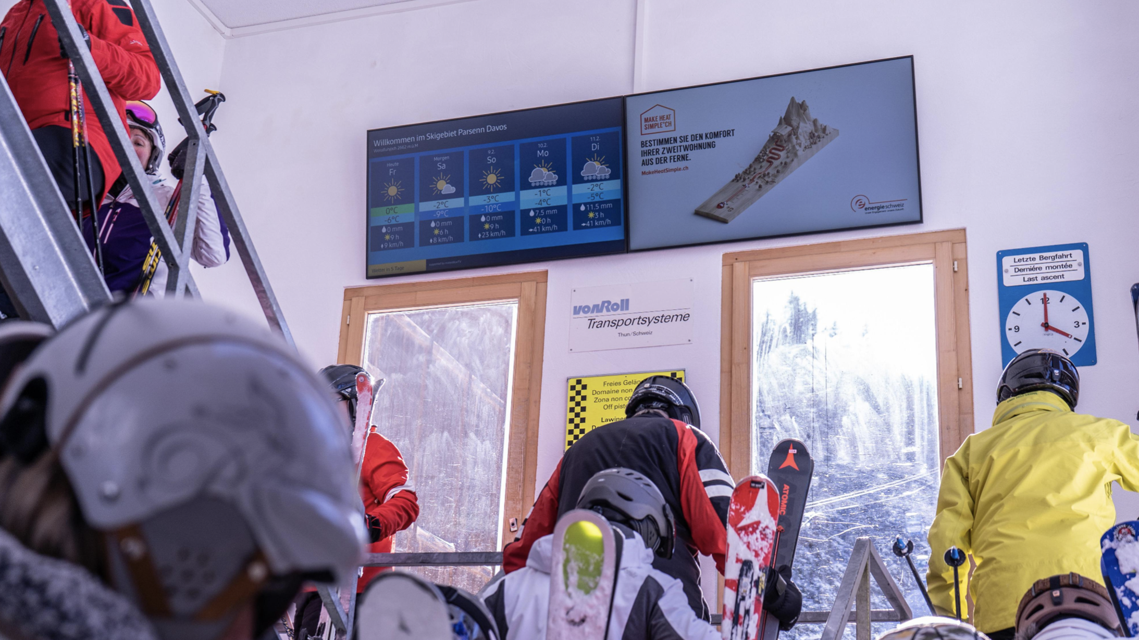
World Economic Forum
Davos 2025

Slide 2
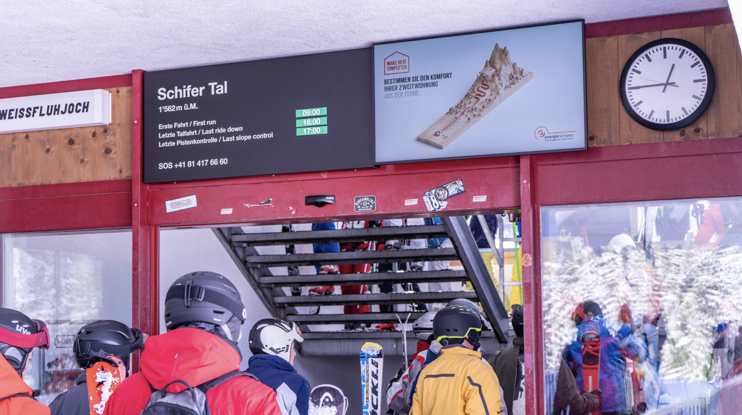
DOOH Davos Klosters
Winter Package
Spec
26 Screens

Slide 3
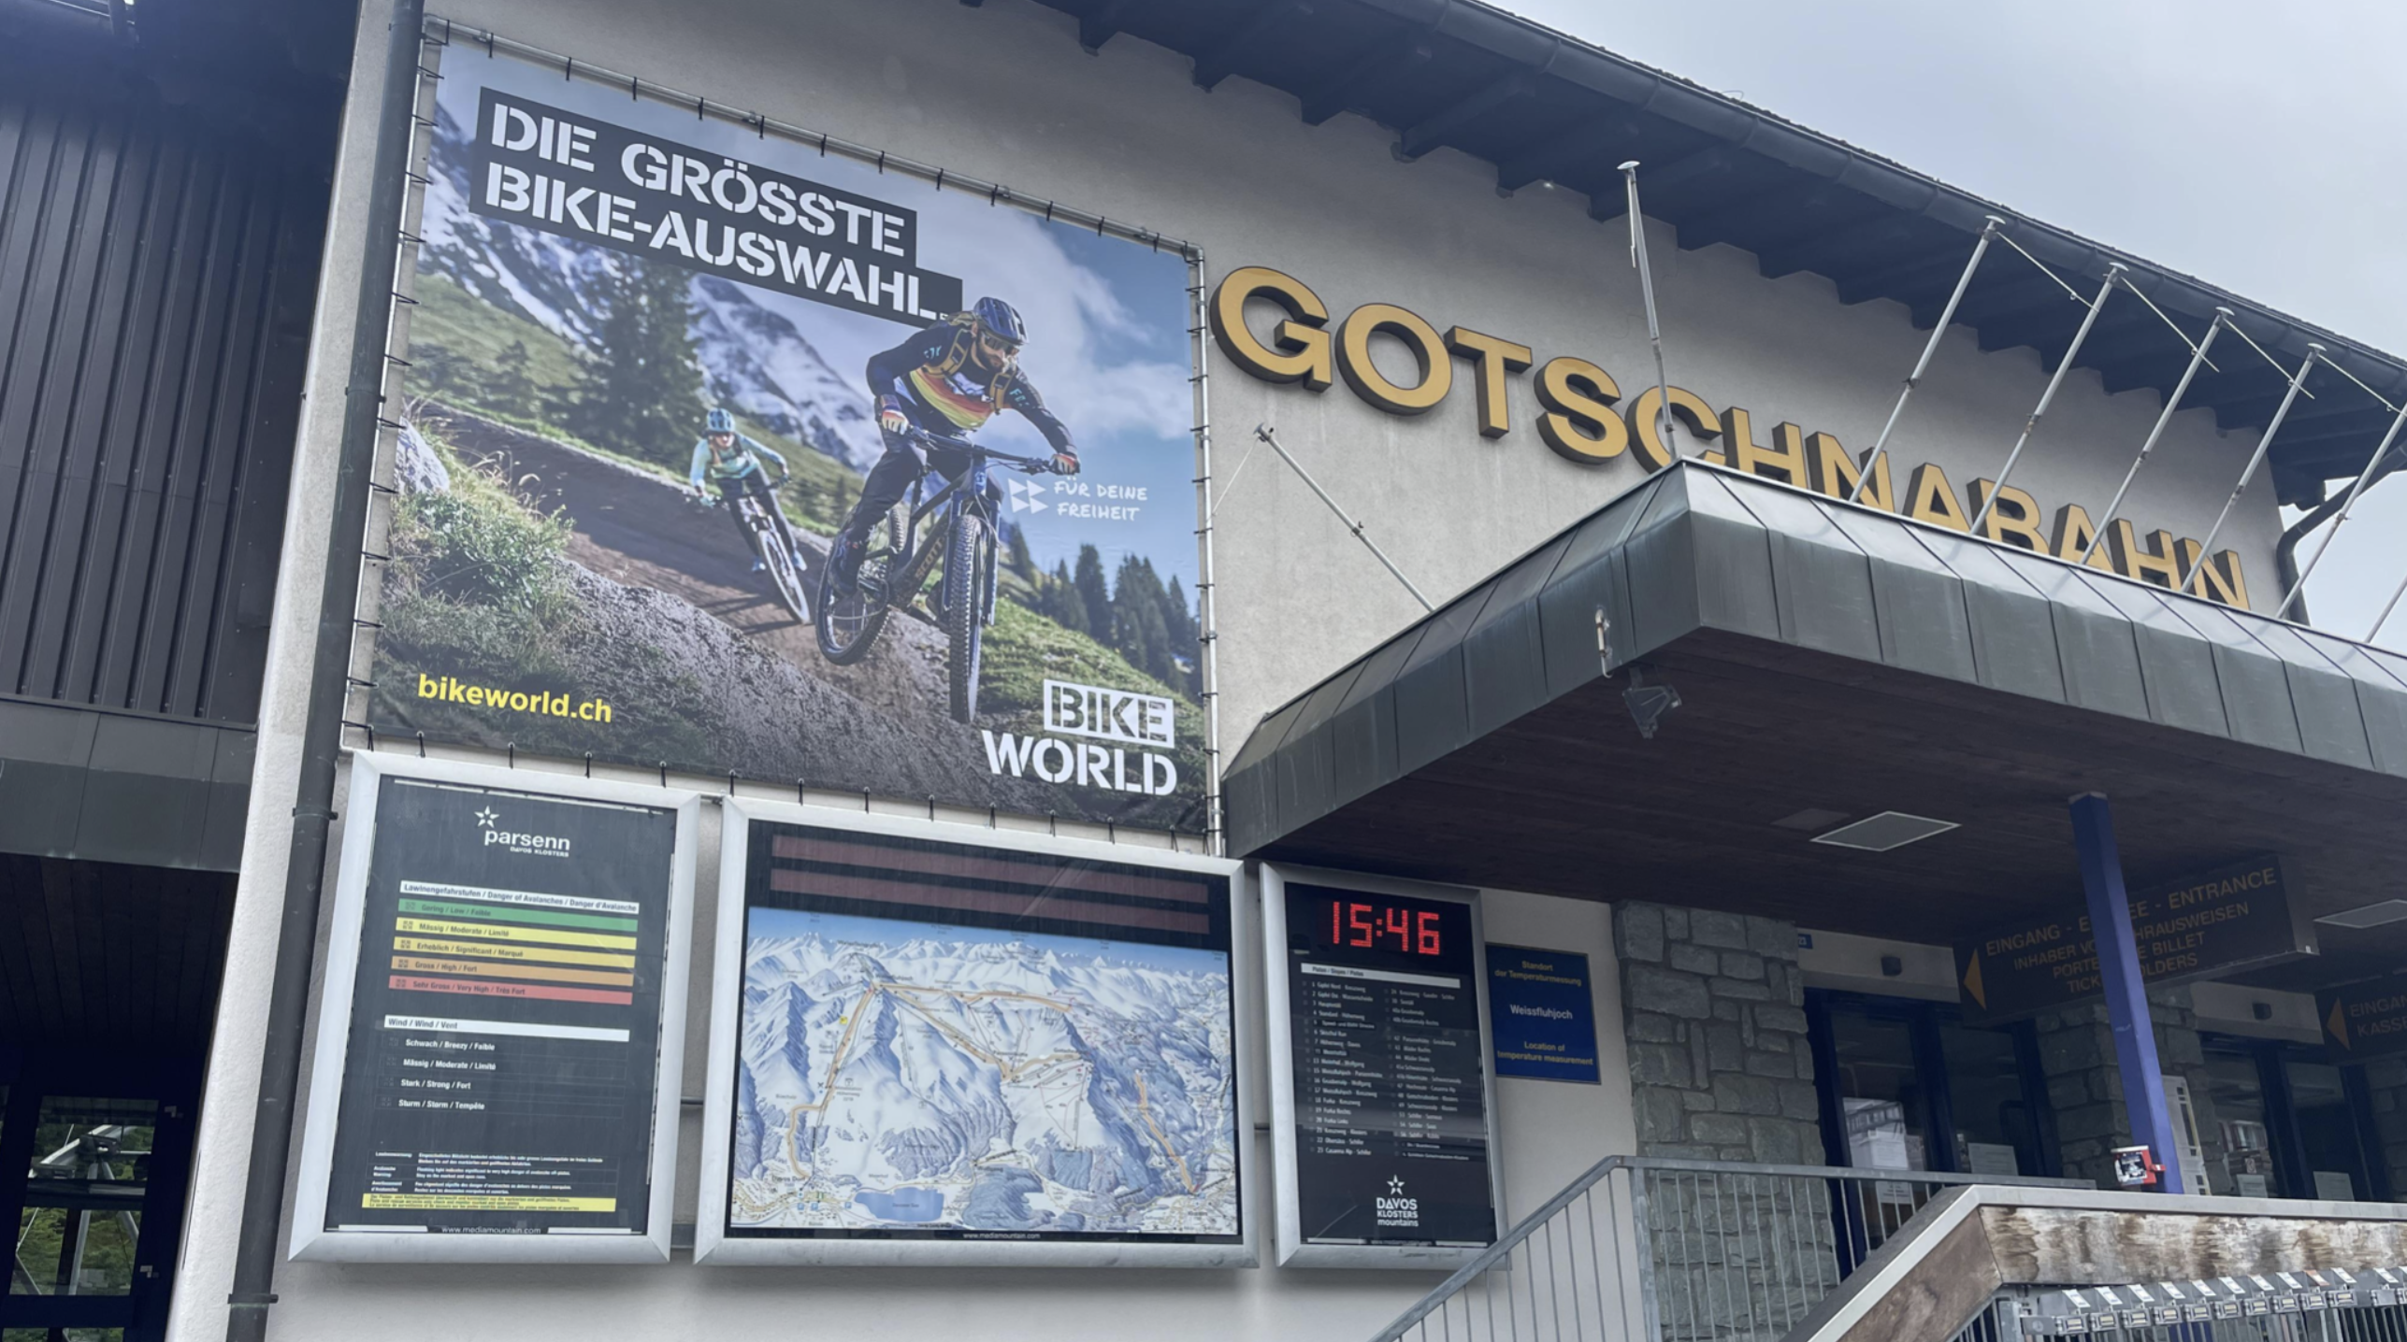
Parsenn – Gotschnabahn
Billboards
Spec
Screen : 1
Size. : 13.52 m² (3.92m x 3.45m )

Slide 4
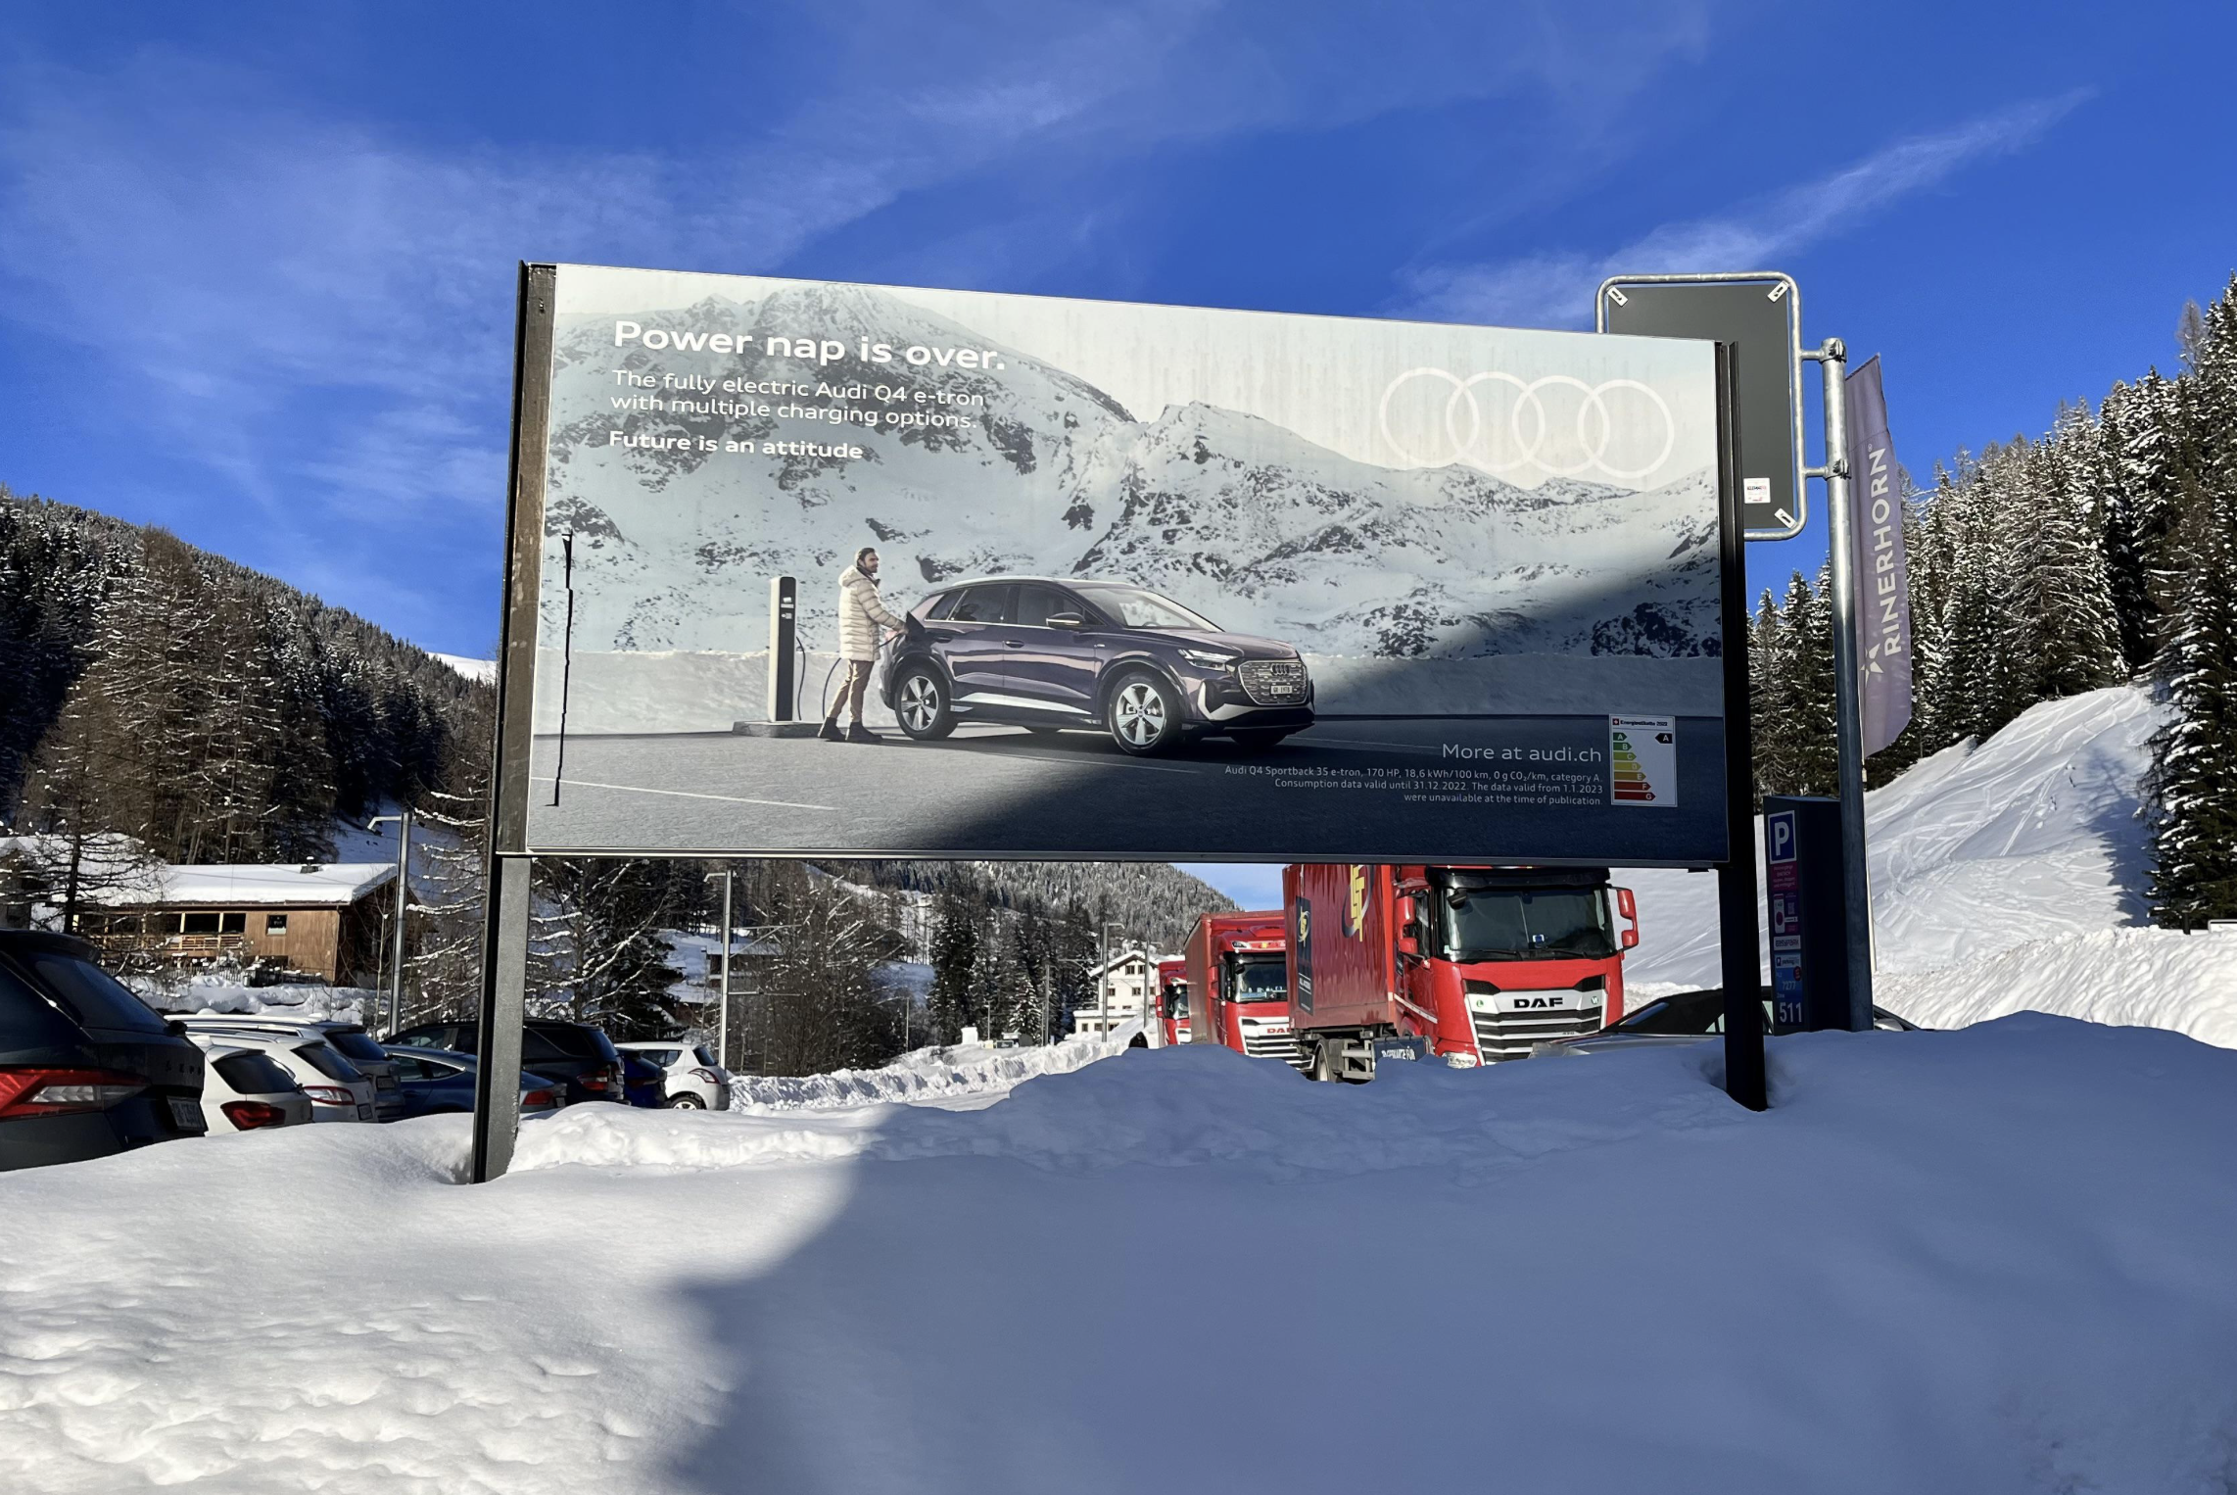
Rinerhorn- Street and
Parking
Spec
Screen : 1
Size. : 3.44 m² (2.69m x 1.28m )

Slide 5
Thank You

