Slide 1
Kansai International Airport Gateway to Osaka Expo 2025: Apr 13 - Oct 13
Engage high-value travellers at Kansai International Airport on their way to the 2025 World Expo. Strategically positioned in key arrival and departure zones, these premium advertising sites ensure maximum exposure to business leaders, decision-makers, and affluent travellers. Only 54 days left – secure your brand’s presence now at Japan’s key international gateway

Slide 2
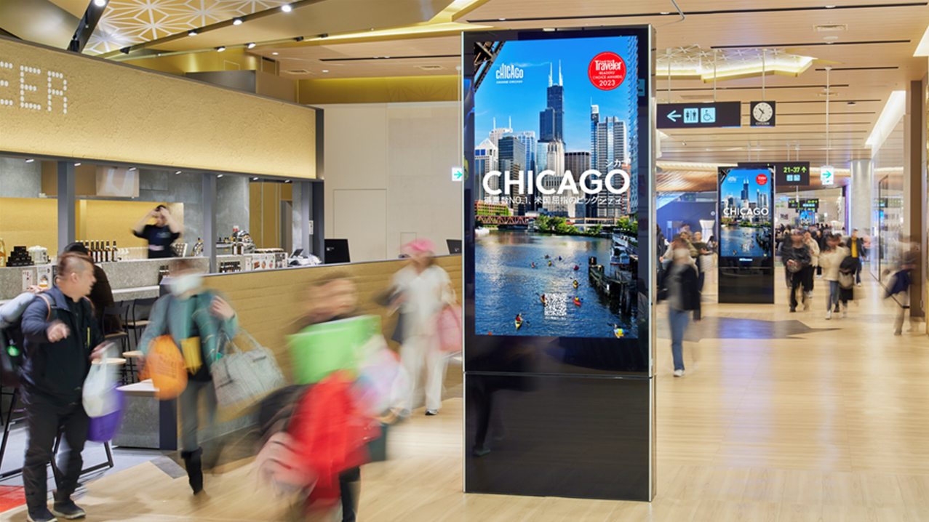
OS 25-KI-01
International Departures
Digital Network
Location details
Departure Air side & Land side. Strategically located to cover all the busiest areas, this network reaches 100% of the audience (passengers as well as meters & greeters) at KIX Kansai International Airport’s international departures.
Spec
24 LCD Portrait screens. 84" | 80' | 75" SOV
Max slots 8 . 1/8= 13% SOV

Slide 3
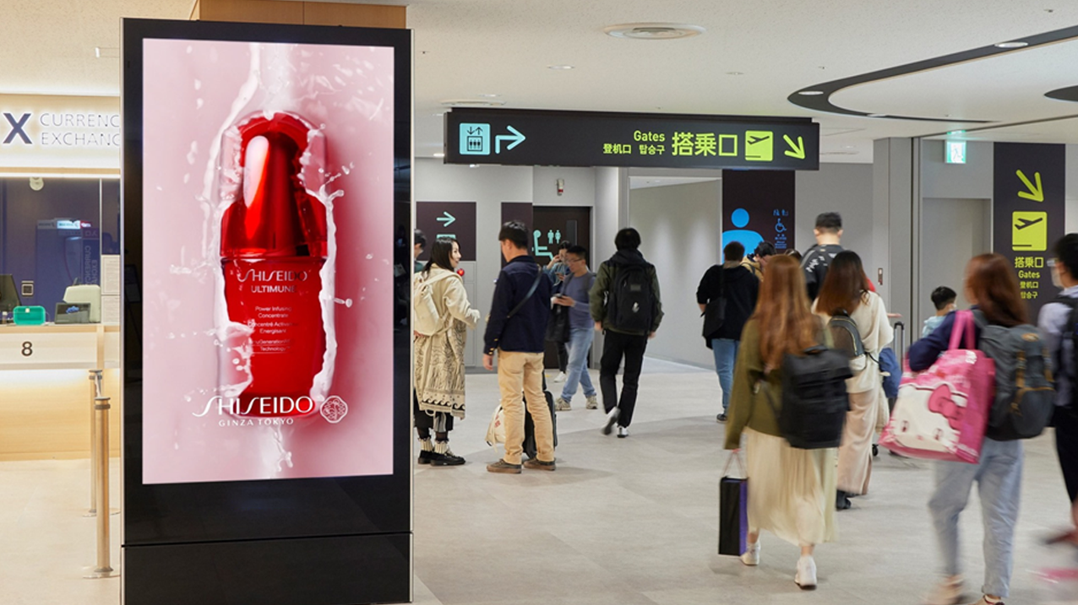
International Departures Digital Network

Slide 4
International Departures Digital Network

Slide 5
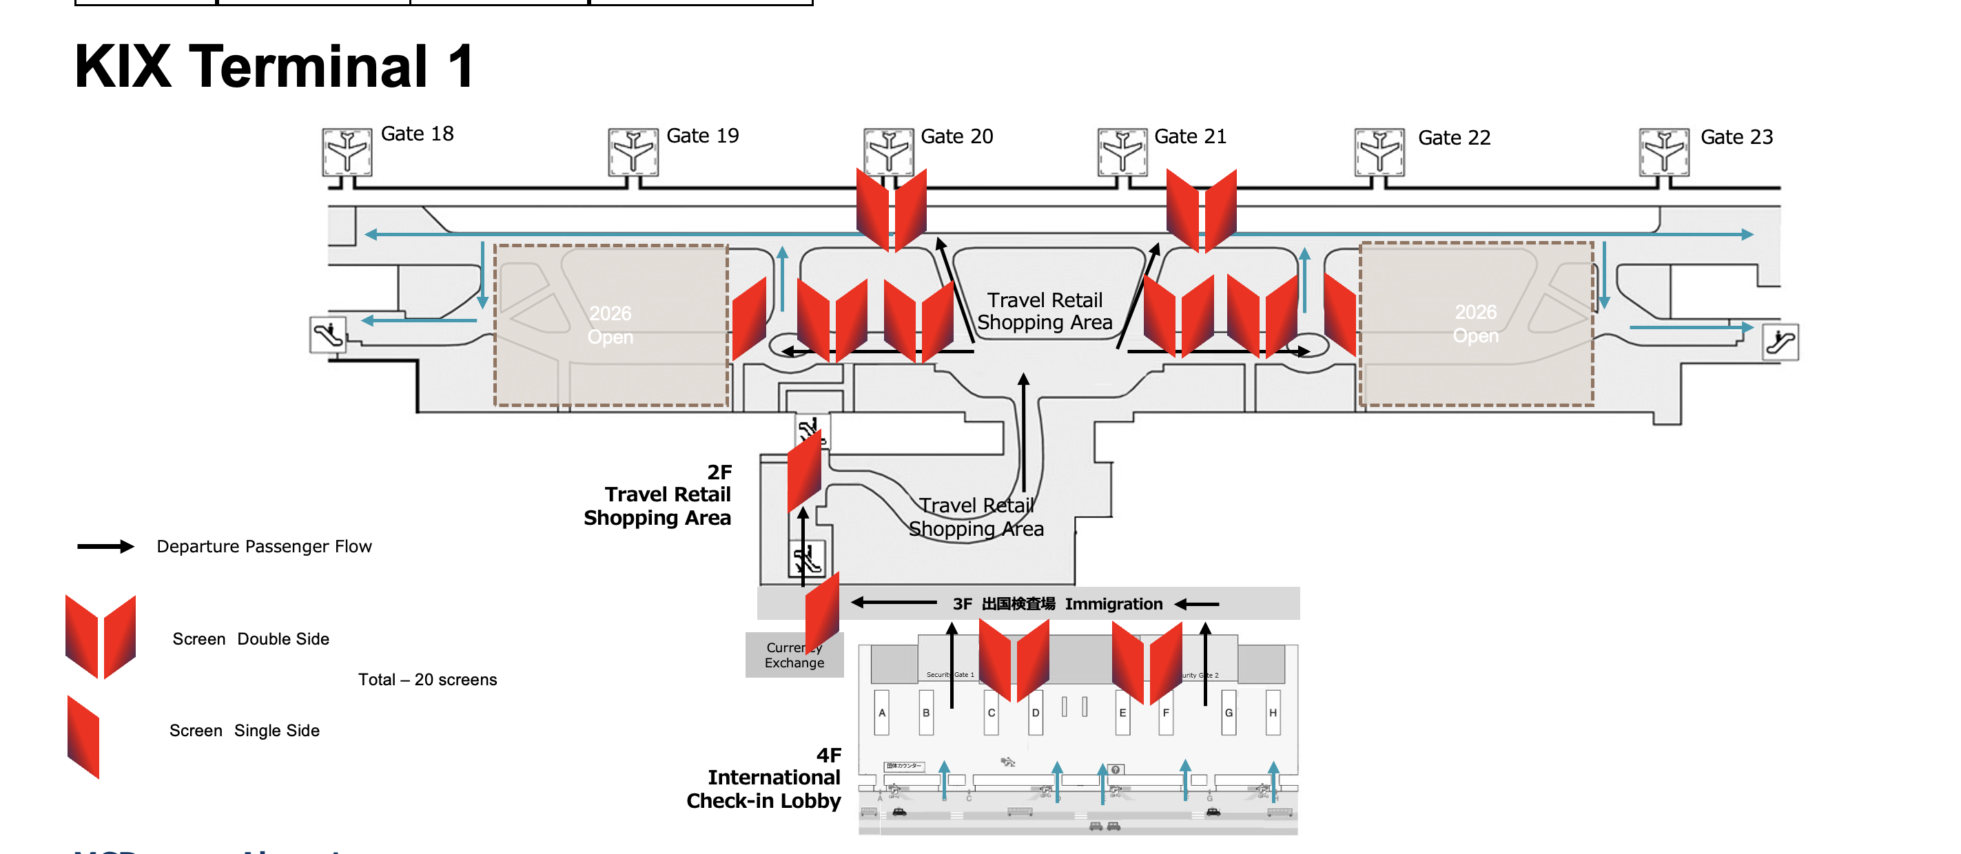
Map View

Slide 6
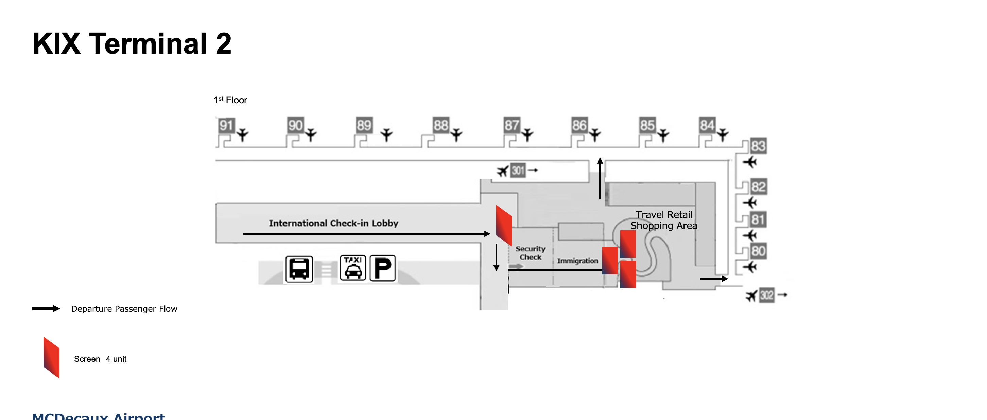
Map View

Slide 7
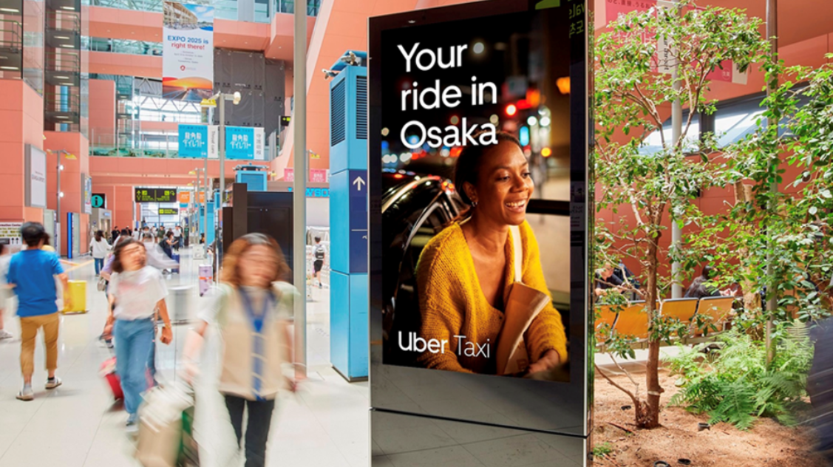
OS 25-KI-02
International Arrivals Digital Network
Location details
Arrivals airside & landside.
Strategically located to cover all the busiest areas, this network reaches 100% of the audience (passengers as well as meters & greeters) at KIX international arrivals.
Spec
9 LCD Portrait screens. 85" | 75“
SOV
Expo period : Max slots 10. 1/10

Slide 8
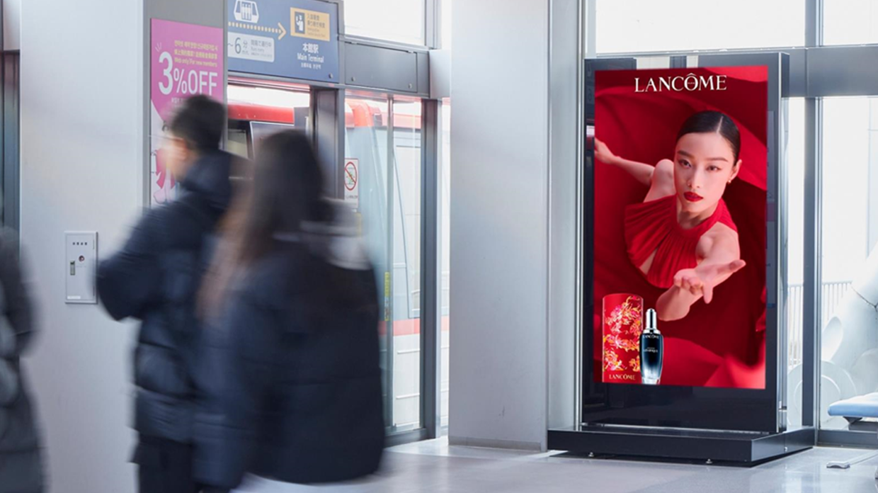
International Arrivals Digital Network

Slide 9
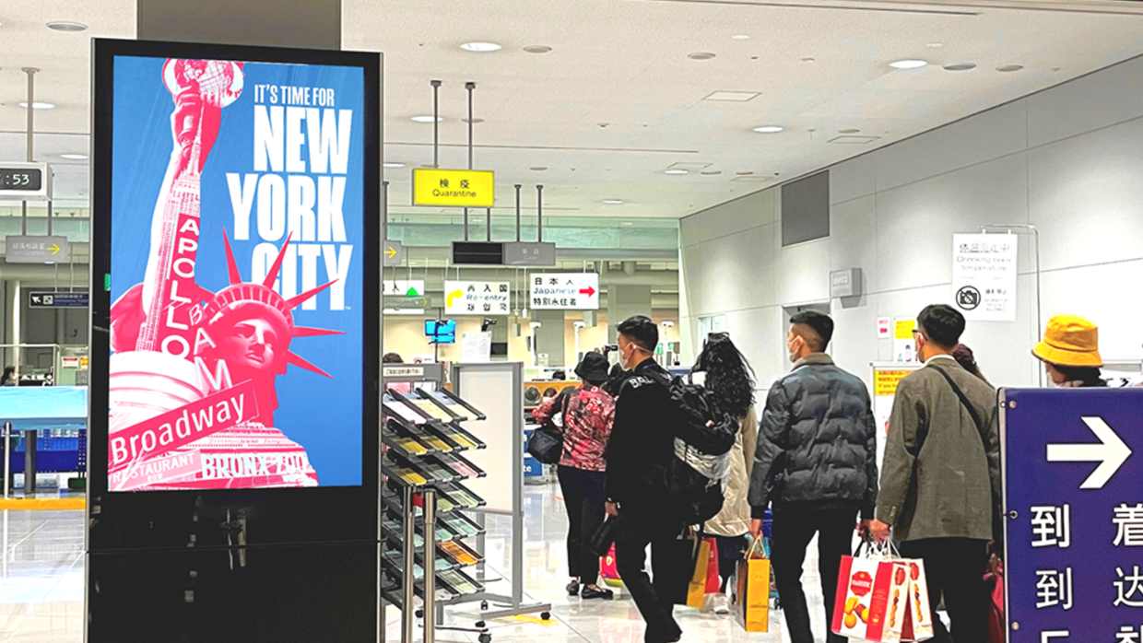
International Arrivals Digital Network

Slide 10
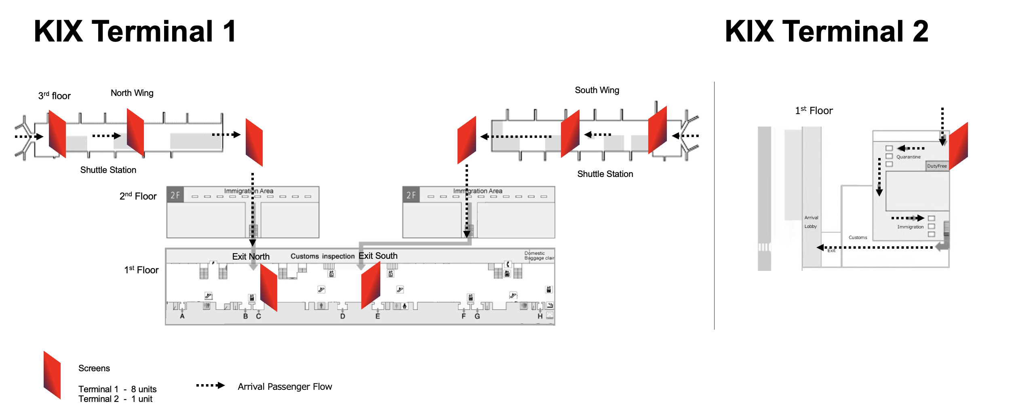
Map View

Slide 11
Thank You

