Slide 1
Top Media
Recommendations
in UAE

Slide 2
Newspaper

Slide 3
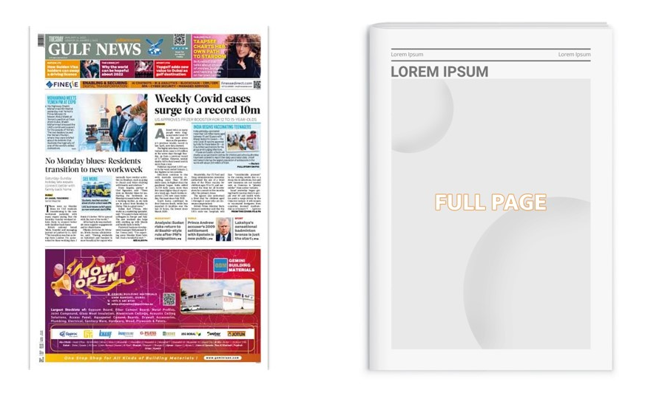
Gulf News, United Arab Emirates
Full Page Ad in Inside Pages, Gulf News, United Arab Emirates
Newspaper

Slide 4
Gulf News, United Arab Emirates
Full Page Ad in Inside Pages, Gulf News, United Arab Emirates
Newspaper
details
Frequency: Daily
Size: TBC
Standard Positions: Full page
Number of production: 1
Number of insertions required: 1

Slide 5
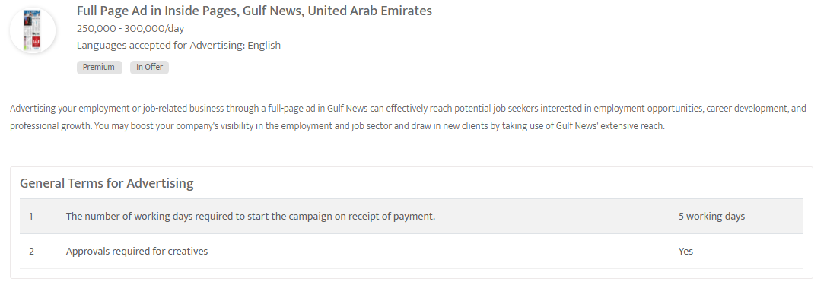

Slide 6
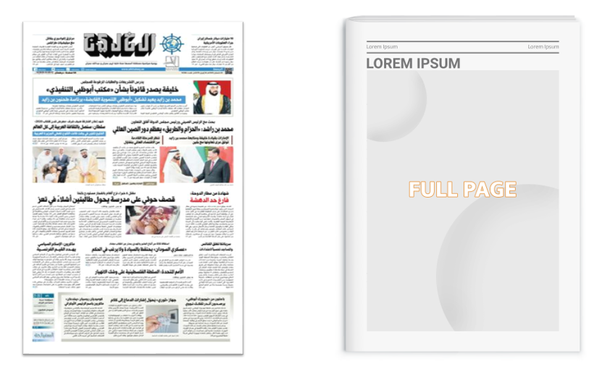
Al Khaleej - Full Page ad on Business page
United Arab Emirates
Newspaper

Slide 7
Al Khaleej - Full Page ad on Business page
United Arab Emirates
Newspaper
details
Frequency: Daily
Size: 54cm (H) x 27cm(W)
Standard Positions: Full page
Number of production: 1
Number of insertions required: 1

Slide 8
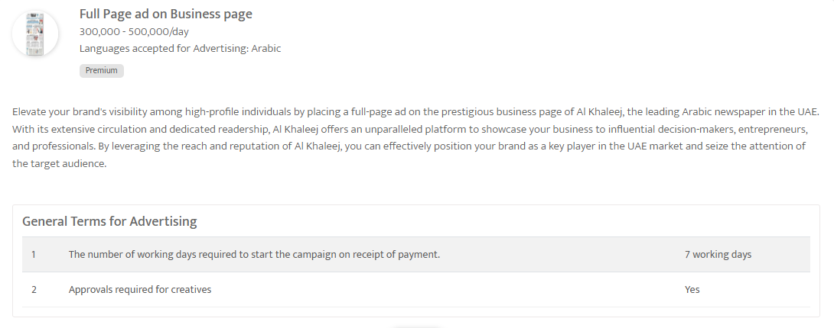

Slide 9
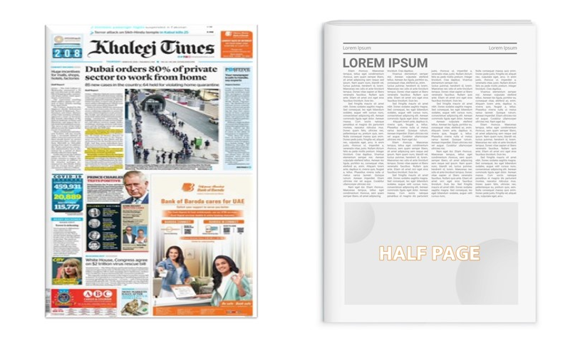
Khaleej Times, United Arab Emirates
Half Page ad in Page 5 in Khaleej Times, United Arab Emirates
United Arab Emirates
Newspaper

Slide 10
Khaleej Times, United Arab Emirates
Half Page ad in Page 5 in Khaleej Times, United Arab Emirates
United Arab Emirates
Newspaper
details
Frequency: Daily
Size: 26cm (H) x 29cm (W)
Standard Positions: Half Page
Number of production: 1
Number of insertions required: 1

Slide 11
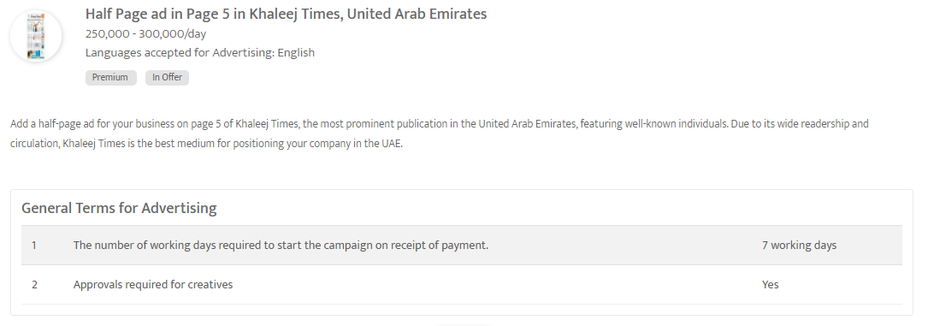

Slide 12
Airports

Slide 13
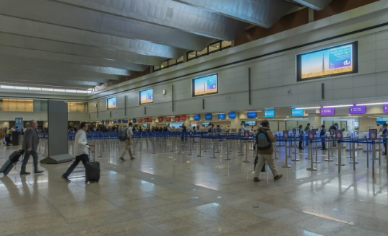
Dubai International Airport, United Arab Emirates
Digital Screens at Arrival Passport Control, Dubai International Airport, United Arab Emirates
Out of Home

Slide 14
Dubai International Airport, United Arab Emirates
Digital Screens at Arrival Passport Control, Dubai International Airport, United Arab Emirates
Out of Home
details
Number of Screens: 4
Lighting type: Back-Lit
Size: 4m (W) X 2m (H)
Number of production: 1
Total number of months required: 1

Slide 15
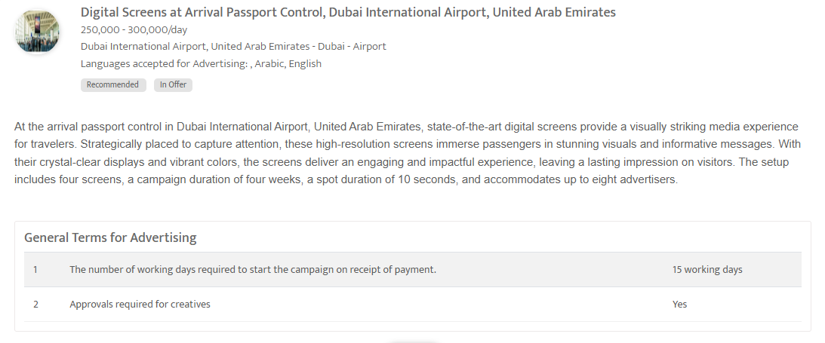

Slide 16
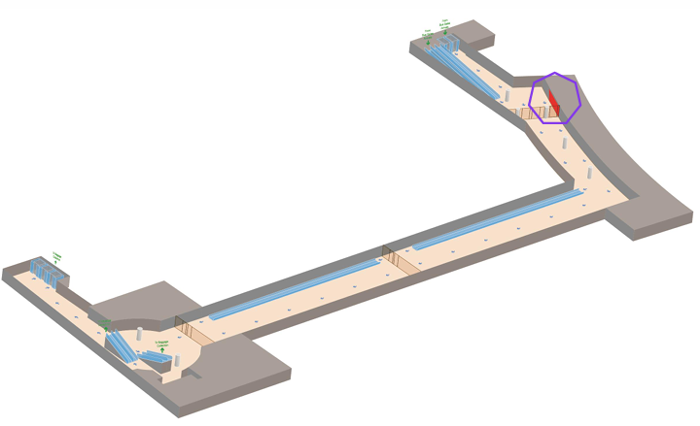
Abu Dhabi International Airport, United Arab Emirates
Wall Wrap at International Arrival En Route to the Passport Control Area; Bus Gate-Abu Dhabi
Out of Home

Slide 18
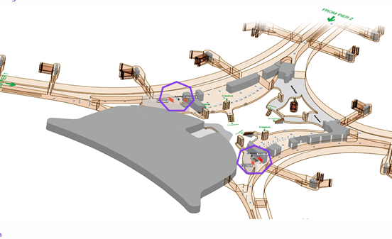

Slide 19
Abu Dhabi International Airport, United Arab Emirates
Wall Wrap at International Arrival En Route to the Passport Control Area; Bus Gate-Abu Dhabi
Out of Home
details
Number of Screens: 5
Lighting type: Non-Lit
Size: Various
Number of production: 1
Total number of months required: 1

Slide 20
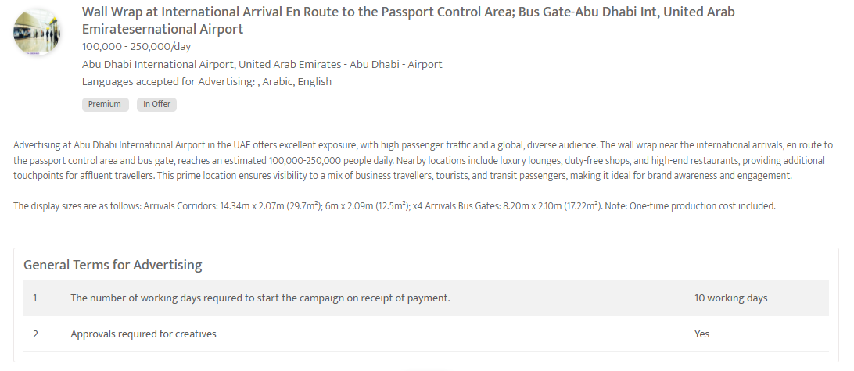

Slide 21
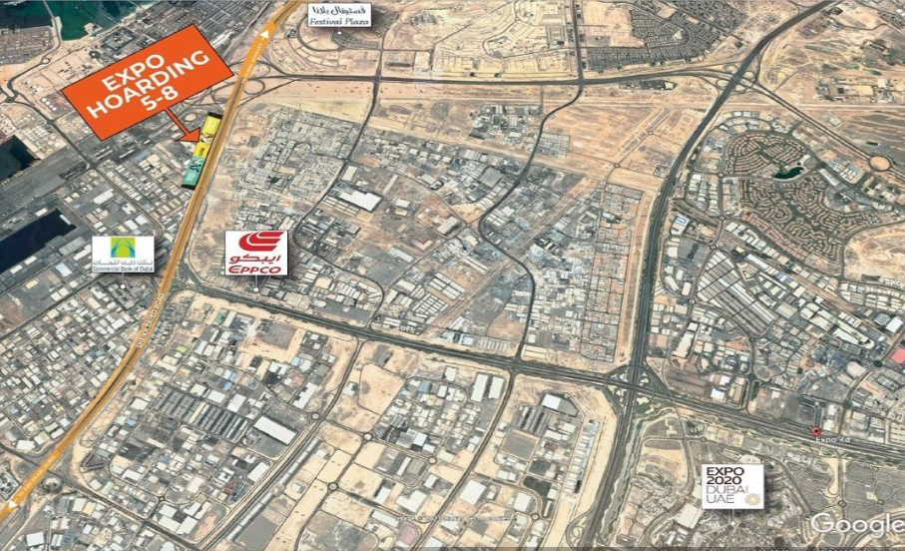
Sheikh Zayed Road - Sharjah - Hoarding near EXPO Bridge, next to Jafza Gate Exit
United Arab Emirates
Out of Home

Slide 22
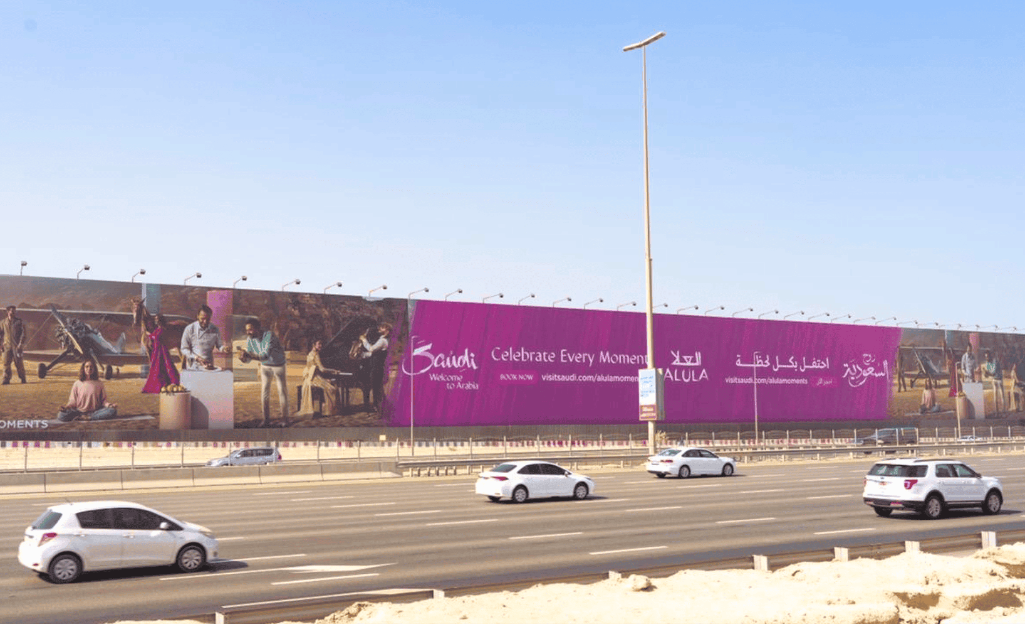

Slide 23
Sheikh Zayed Road - Sharjah - Hoarding near EXPO Bridge, next to Jafza Gate Exit
United Arab Emirates
Out of Home
details
Number of Screens: 1
Lighting type: Non-Lit
Size: 200 m x 17 m
Number of production: 1
Total number of months required: 1

Slide 24
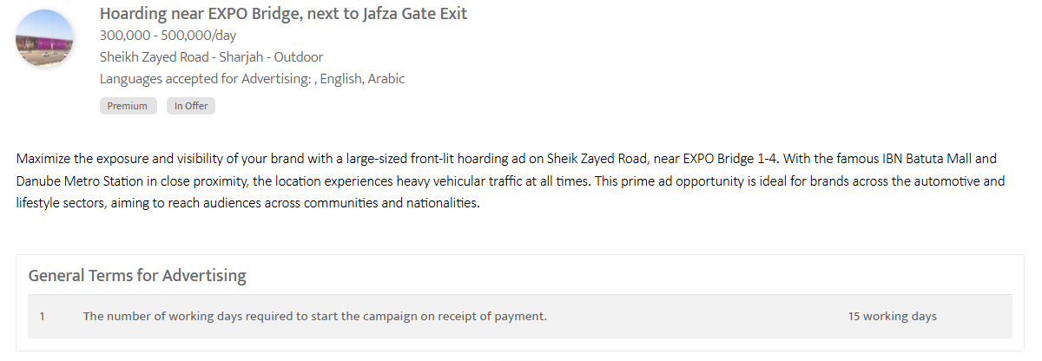

Slide 25
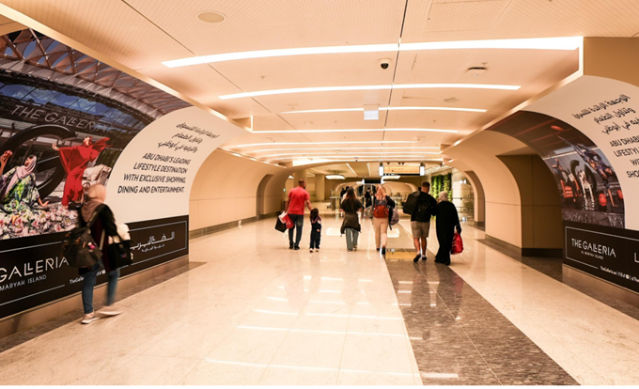
Abu Dhabi International Airport, United Arab Emirates
Wall Wrap En Route to immigration, at International Arrival- Abu Dhabi International Airport
Out of Home

Slide 26
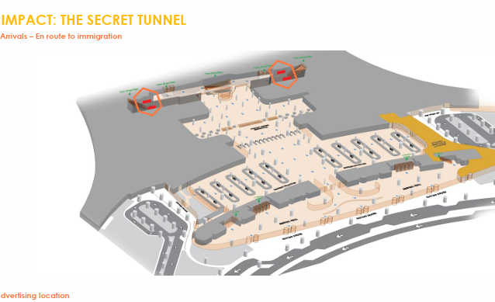

Slide 27
Abu Dhabi International Airport, United Arab Emirates - Abu Dhabi - Wall Wrap En Route to immigration, at International Arrival- Abu Dhabi International Airport
Out of Home
Details
Number of Screens: 4
Lighting type: Non-Lit
Size: Various
Number of production: 1
Total number of months required: 1

Slide 28
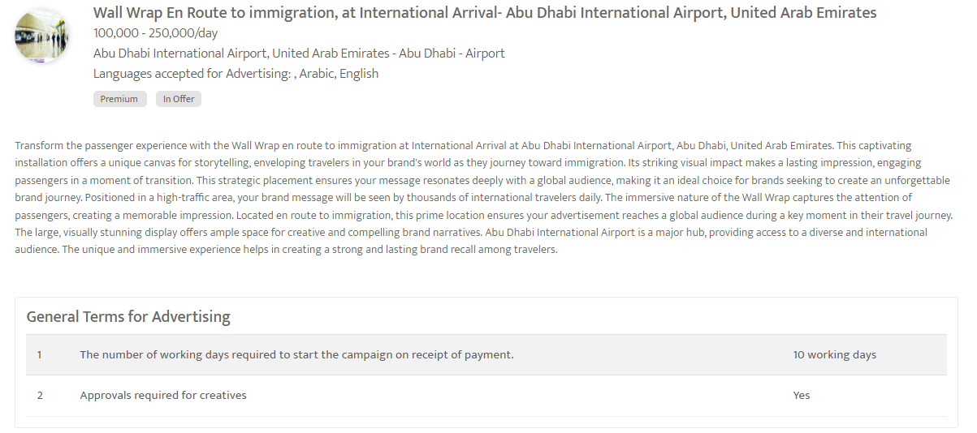

Slide 29
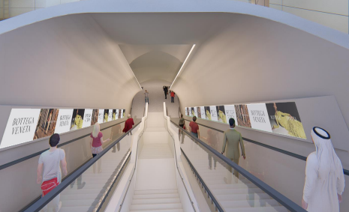
Abu Dhabi International Airport, United Arab Emirates
Digital Screens at Marhaba Grand Tunnel, International Arrival, Abu Dhabi International Airport
Out of Home

Slide 30
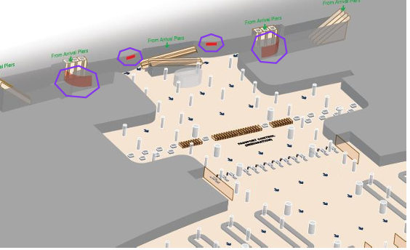

Slide 32
Abu Dhabi International Airport, United Arab Emirates
Digital Screens at Marhaba Grand Tunnel, International Arrival, Abu Dhabi International Airport
Out of Home
Details
Number of Screens: 6
Lighting type: Non-Lit
Size: Various
Number of production: 1
Total number of months required: 1

Slide 33
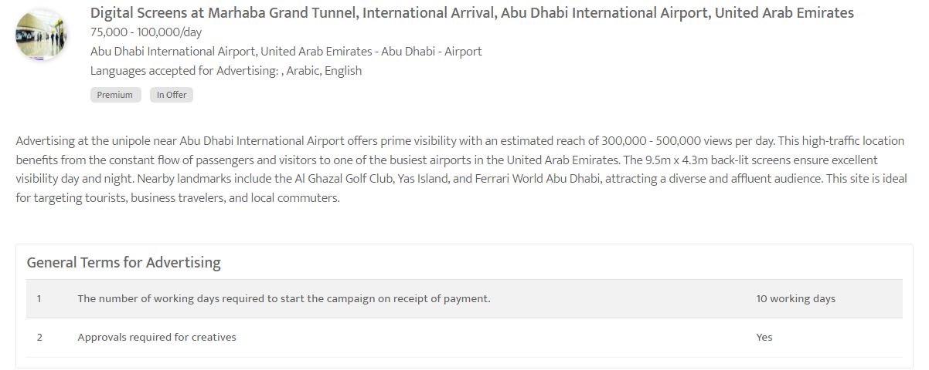

Slide 34
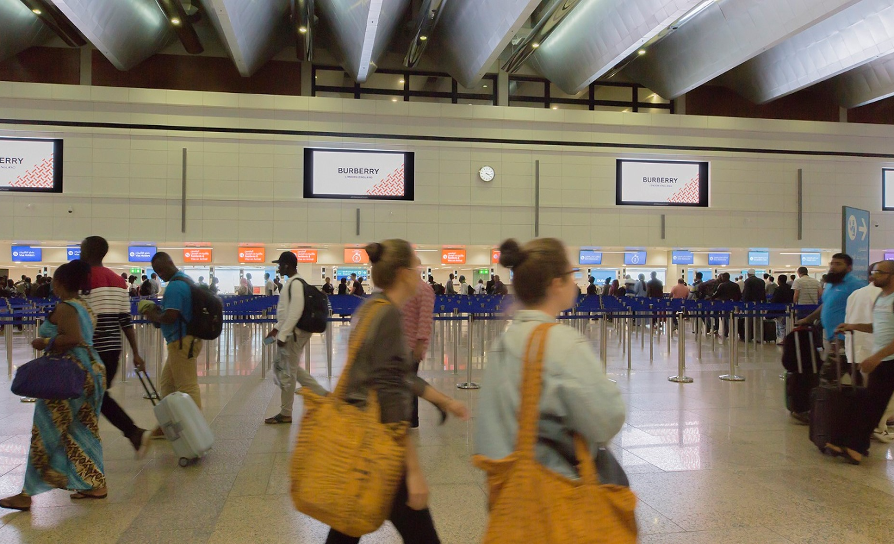
Dubai International Airport, United Arab Emirates
Digital Screens at Immigration Grand Screens T1 B Airport
Out of Home

Slide 35
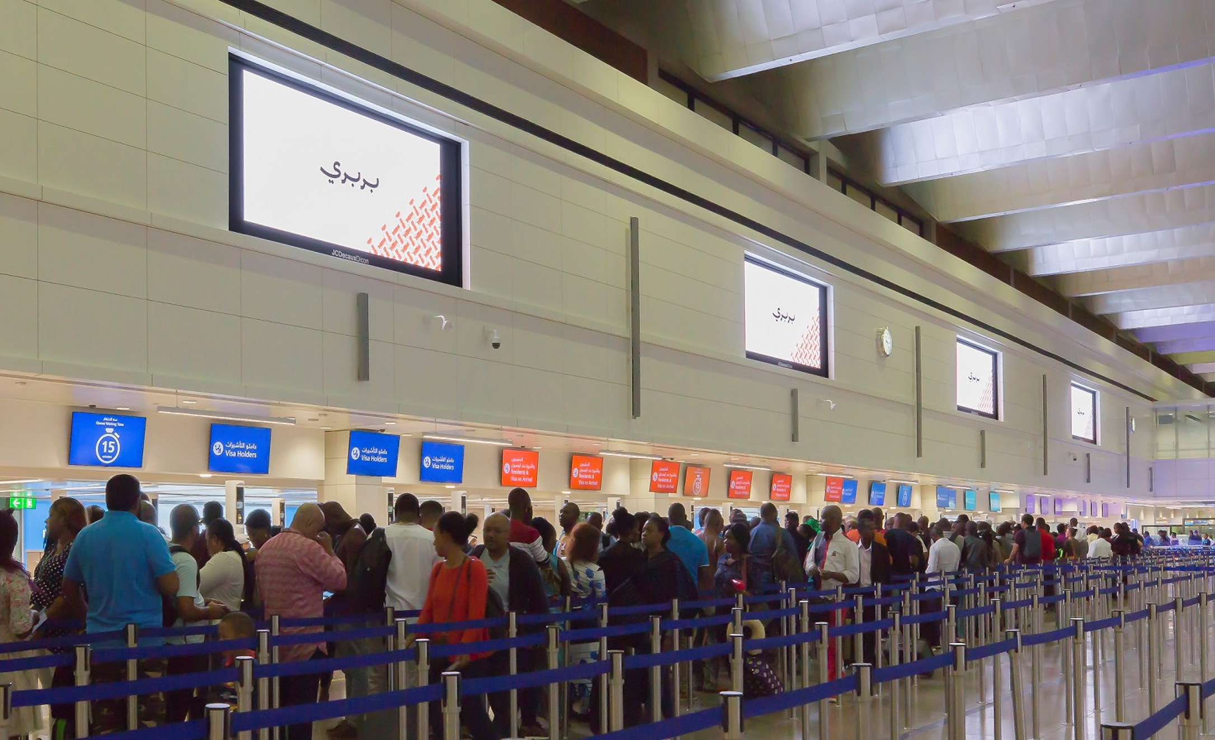

Slide 36
Dubai International Airport, United Arab Emirates
Digital Screens at Immigration Grand Screens T1 B Airport
Out of Home
Details
Number of Screens: 4
Lighting type: Lit
Size: 2m (H) x 4m (W)
Number of production: 1
Total number of months required: 1

Slide 37
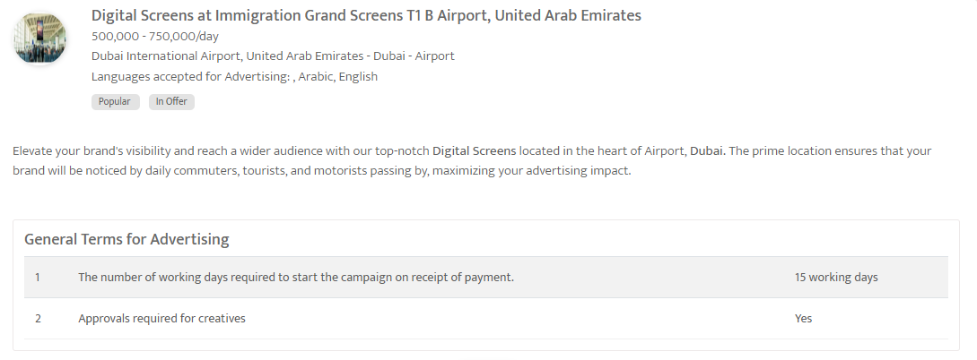

Slide 38
Out of home

Slide 39
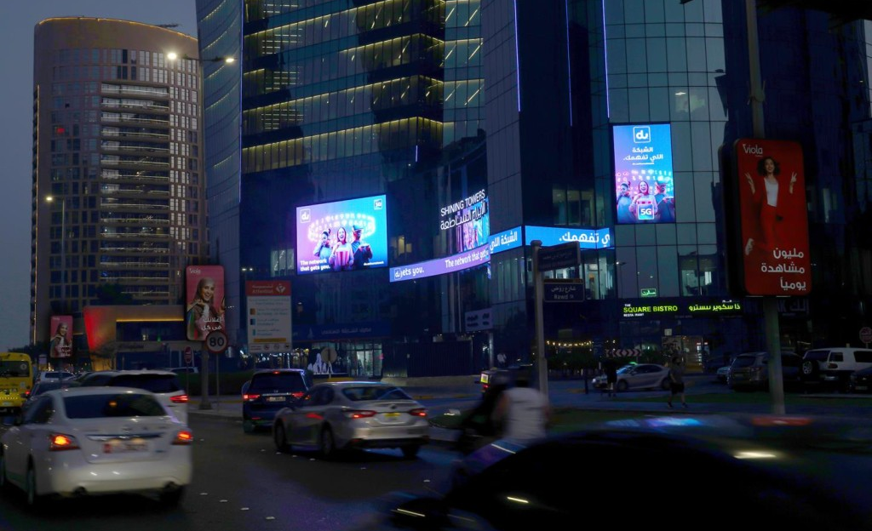
Arterial Roads, Khalidiya, Abu Dhabi, United Arab Emirates
LED Screen at Arterial Roads, Al Khalidiya, Abu Dhabi
Out of Home

Slide 40
Arterial Roads, Khalidiya, Abu Dhabi, United Arab Emirates
LED Screen at Arterial Roads, Al Khalidiya, Abu Dhabi
Out of Home
Details
Number of Screens: 3
Lighting type: Lit
Size: TBC
Single Rotation Time in Seconds: 50
Duration of creative in seconds: 10
Number of production: 1
Total number of months required: 1

Slide 41
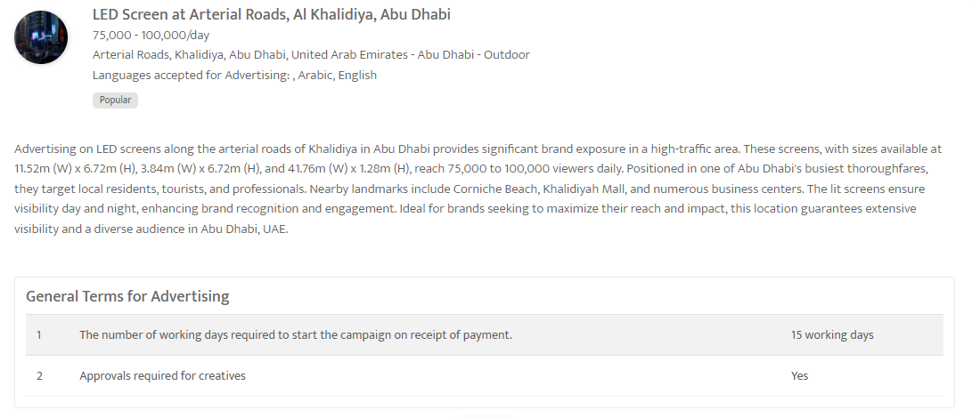

Slide 42
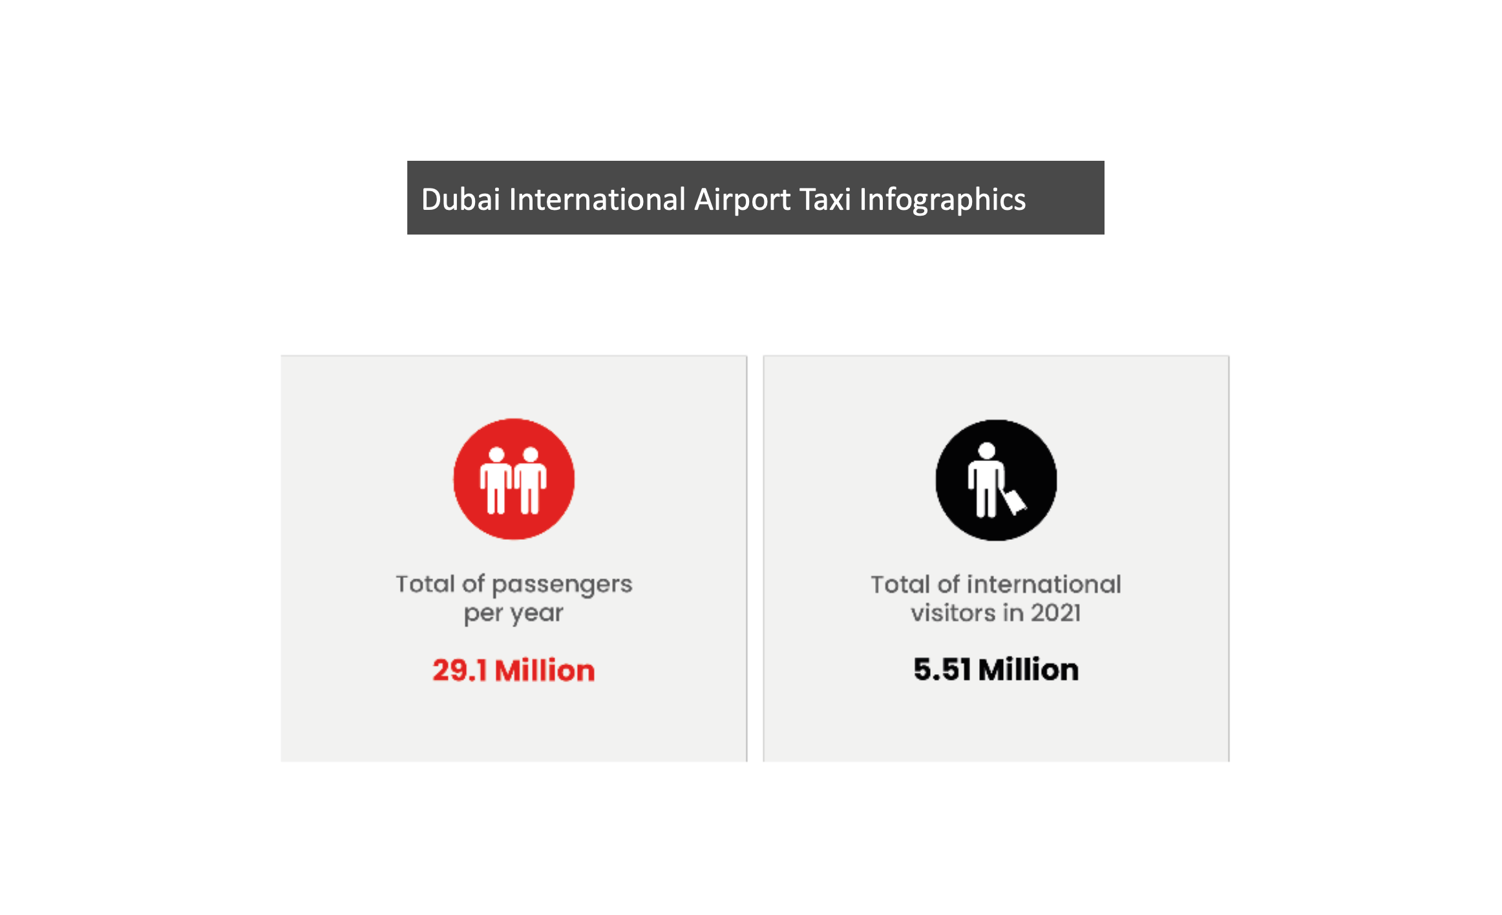
Dubai International Airport Taxis, United Arab Emirates
Advertising on Taxis- Dubai International Airport
Out of Home

Slide 43
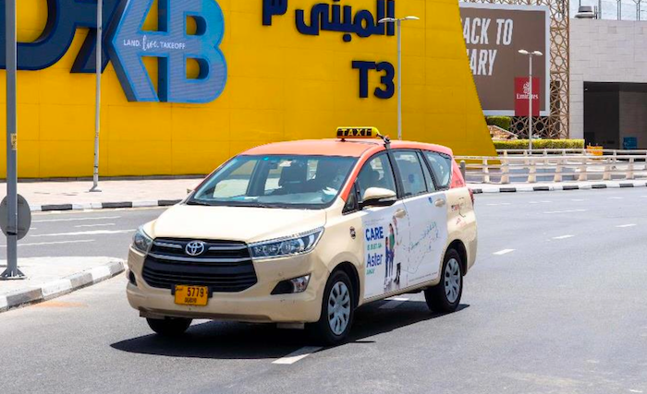

Slide 45
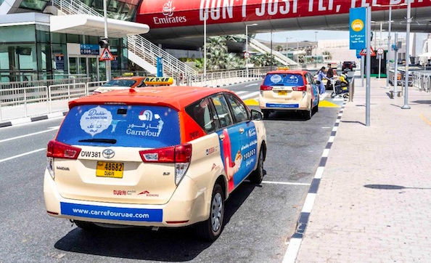

Slide 46
Dubai International Airport Taxis, United Arab Emirates
Advertising on Taxis- Dubai International Airport
Out of Home
Details
Number of Screens: 25
Number of production: 1

Slide 47
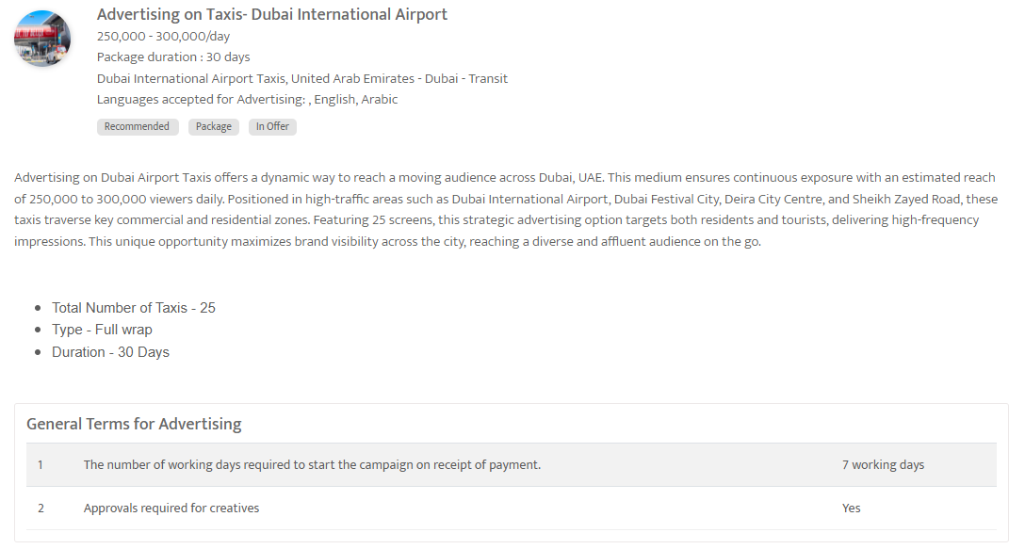

Slide 48
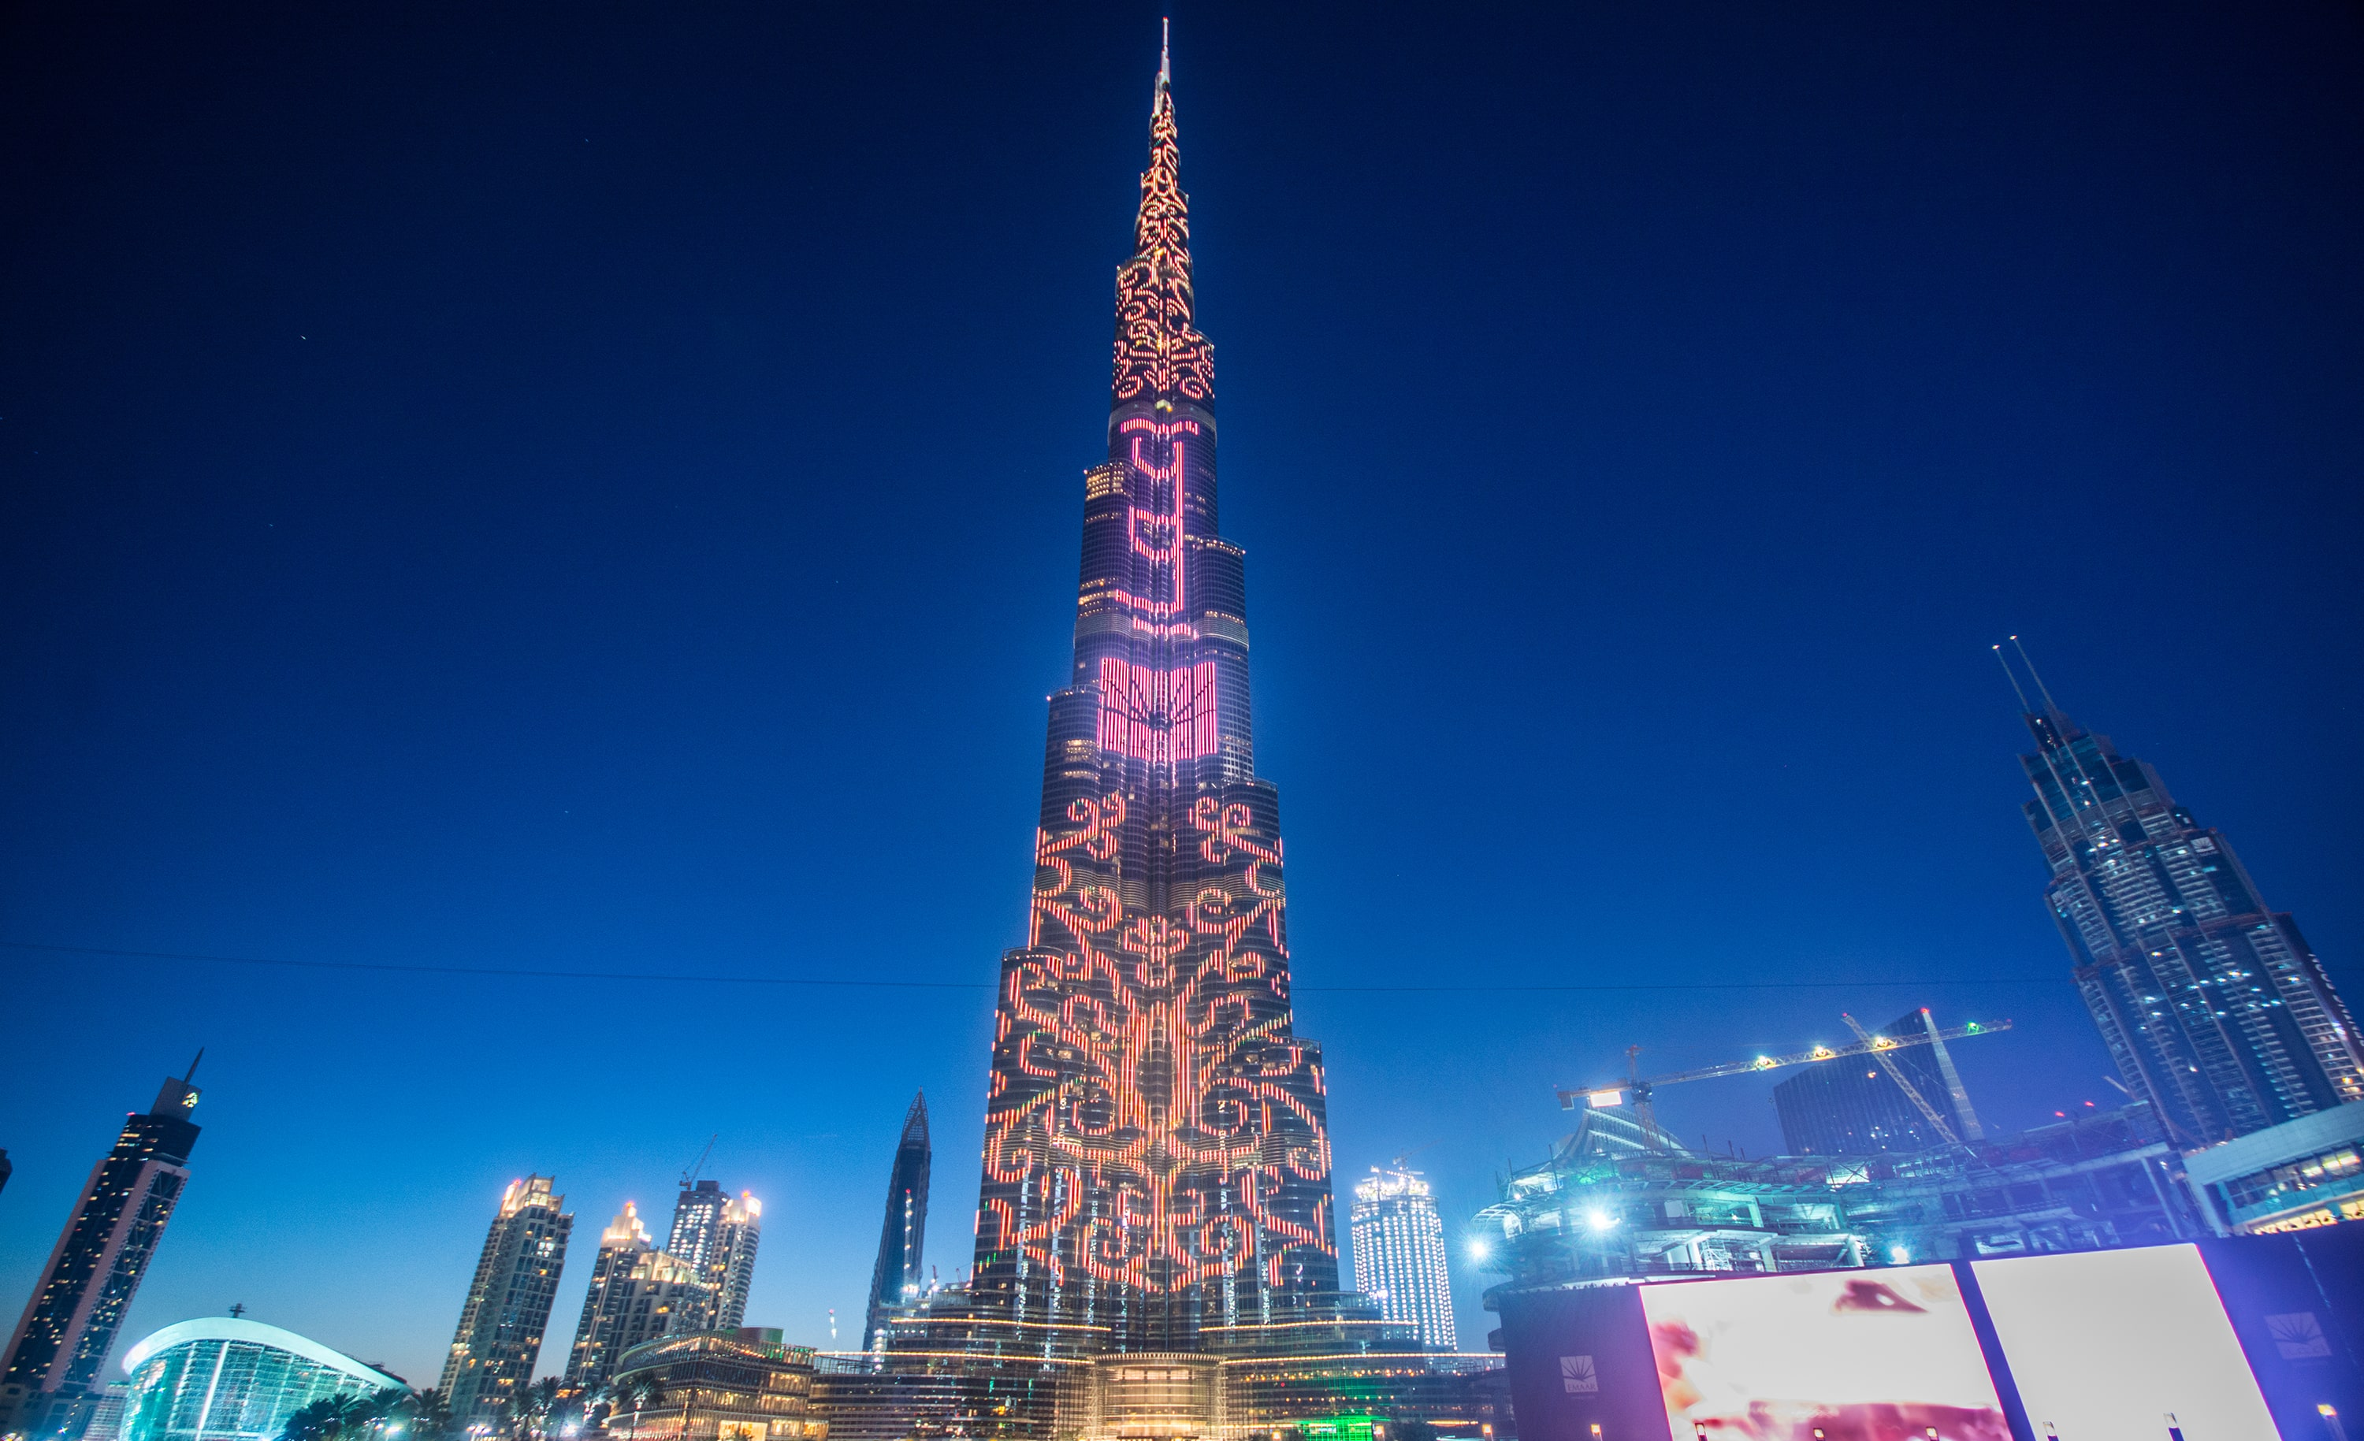
Reach the Peak Like No Other with Burj Khalifa, in Dubai, United Arab Emirates
LED screen ad on Burj Khalifa- Dubai
Out of Home

Slide 49
Reach the Peak Like No Other with Burj Khalifa, in Dubai, United Arab Emirates
LED screen ad on Burj Khalifa United Arab Emirates
Out of Home
Details
Number of Screens: 1
Lighting type: Lit
Size: 6240 px(H) X 1576 px
Single Rotation Time in Seconds: None
Duration of creative in seconds: 180
Number of production: 1
Total number of months required: 1

Slide 50
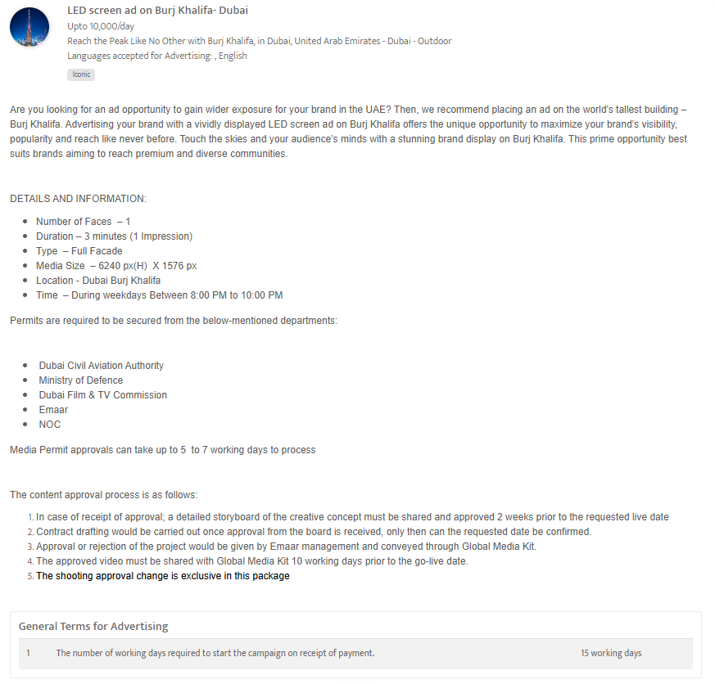

Slide 51
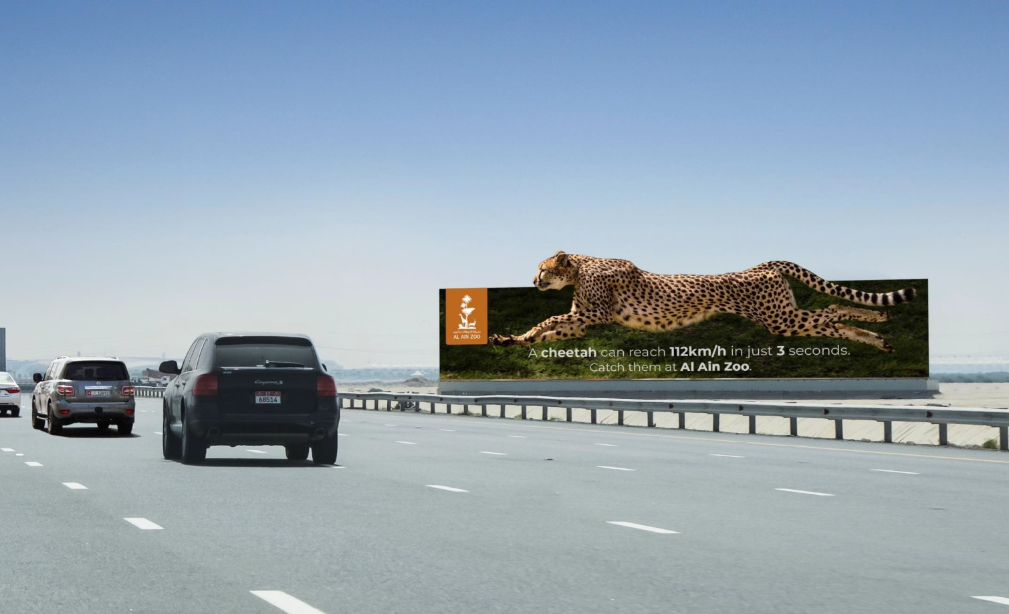
Saadiyat-Yas highway, Abu Dhabi, United Arab Emirates
Mega Hoarding at Saadiyat-Yas highway, Abu Dhabi
Out of Home

Slide 52
Saadiyat-Yas highway, Abu Dhabi, United Arab Emirates
Mega Hoarding at Saadiyat-Yas highway, Abu Dhabi
Out of Home
Details
Number of Screens: 1
Lighting type: Lit
Size: 71m (W) x 12m (H)
Number of production: 1
Total number of months required: 1

Slide 53
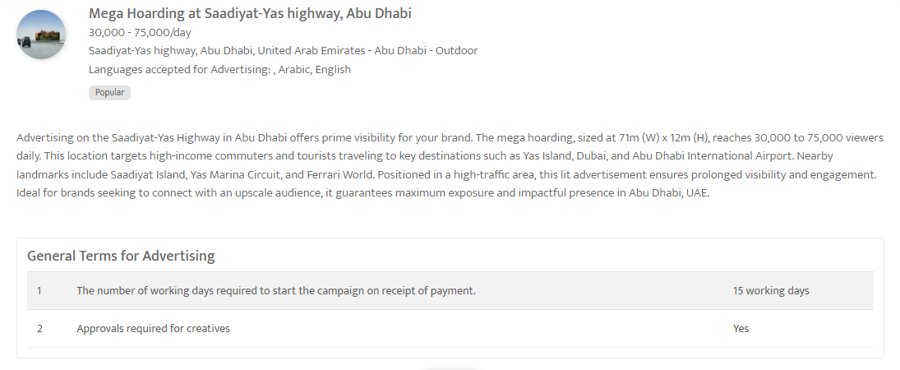

Slide 54
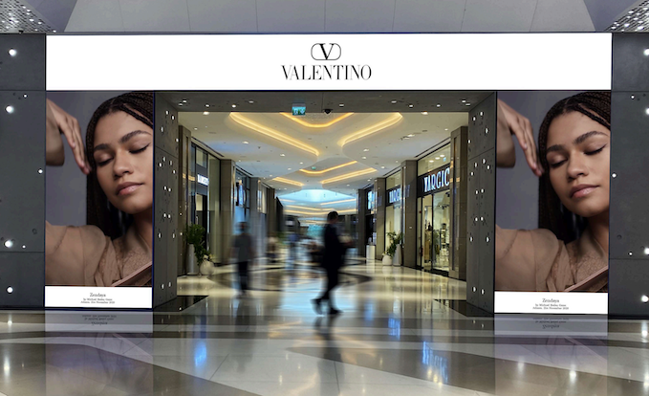
Strategic Outdoor Recommendation in Dubai's Prime Business Hubs
Prime Recommendation Targeting Business Audience
Out of Home

Slide 55
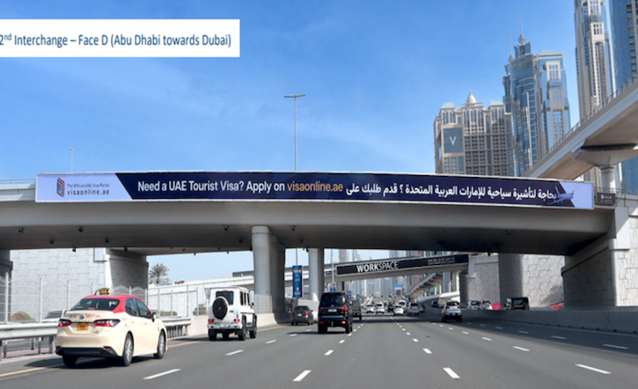

Slide 56
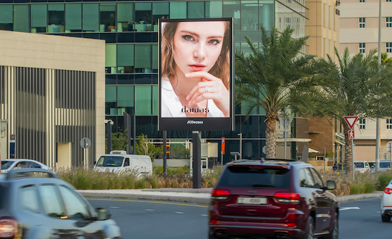

Slide 57
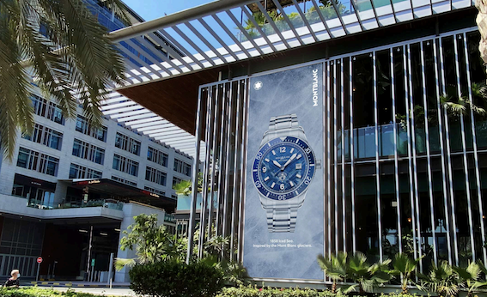

Slide 58
Strategic Outdoor Recommendation in Dubai's Prime Business Hubs
Prime Recommendation Targeting Business Audience
Out of Home
Details
Number of Screens: 30
Number of production: 1

Slide 59
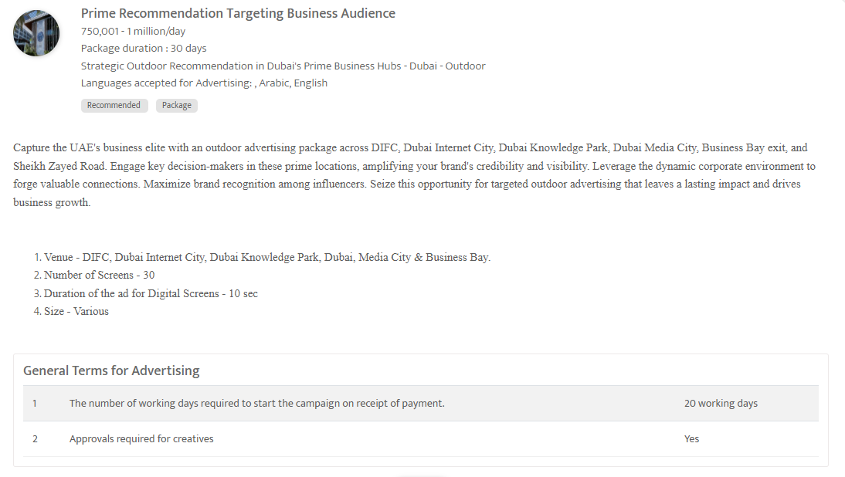

Slide 60
Top Malls

Slide 61
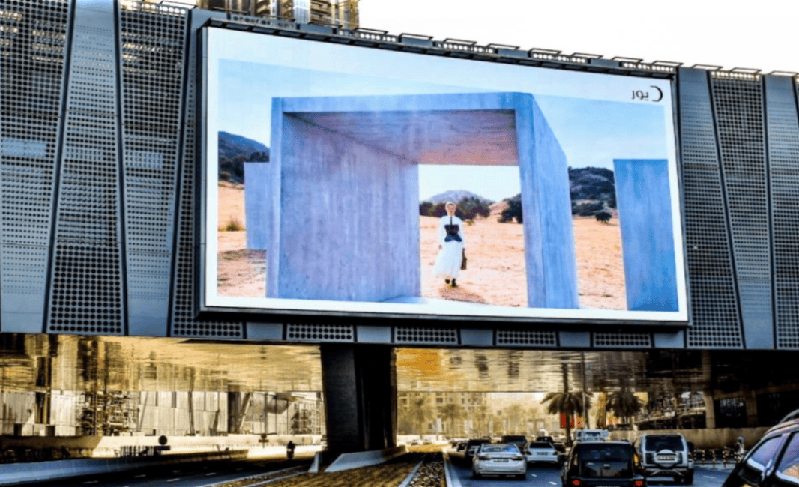
Dubai mall, Dubai, United Arab Emirates
Digital Screen at the entrance to Dubai mall
Out of Home

Slide 62
Dubai mall, Dubai, United Arab Emirates
Digital Screen at the entrance to Dubai mall, United Arab Emirates
Out of Home
Details
Number of Screens: 2
Lighting type: Lit
Size: 2560px W x 1440px H
Single Rotation Time in Seconds: 300
Duration of creative in seconds: 15
Number of production: 1
Total number of months required: 1

Slide 63
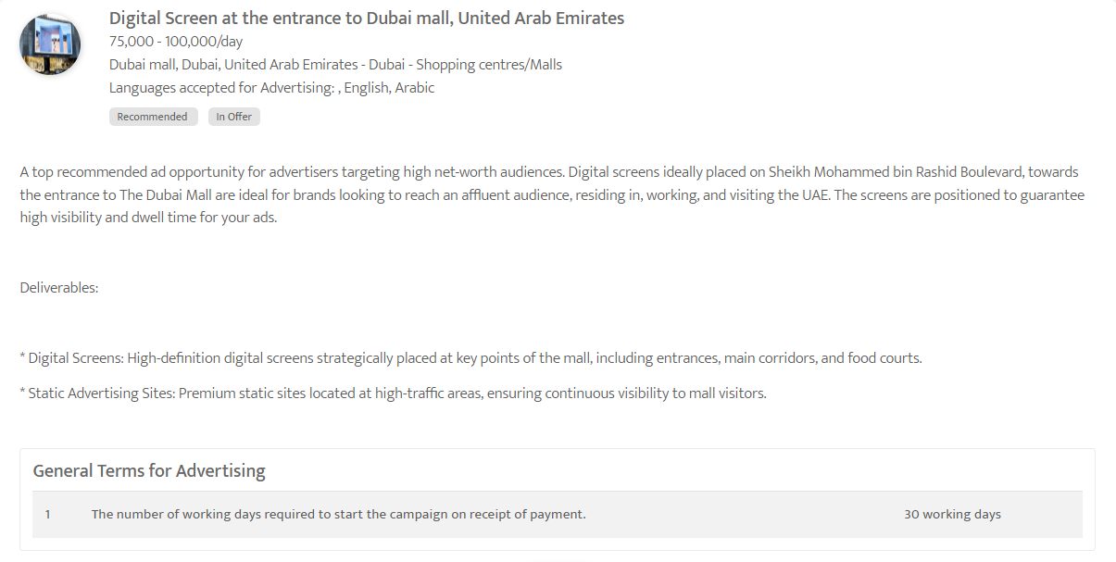

Slide 64
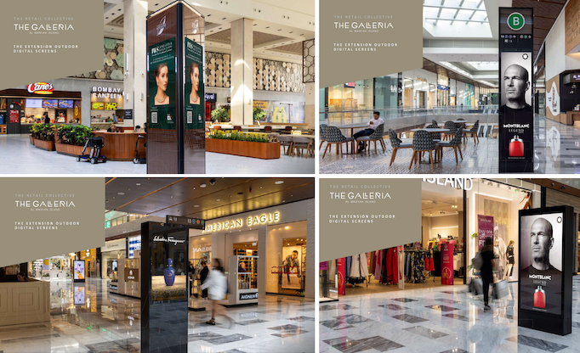
Elevate your Brand in UAE's Top Malls- Dubai, Abu Dhabi & Sharjah
Digital Screens Across Top Malls in UAE- Marina, Hills, and The Galleria Malls
Out of Home

Slide 65
Elevate your Brand in UAE's Top Malls- Dubai, Abu Dhabi & Sharjah
Digital Screens Across Top Malls in UAE- Marina, Hills, and The Galleria Malls
Out of Home
Details
Number of Screens: 254
Number of production: 1
One time production cost: USD 0.00
Package Rental Rate: USD 69697.32
Discounted rate/Month (Rental): USD 62727.59
Sub Total (Rental+ One Time Production): USD 62727.59

Slide 66
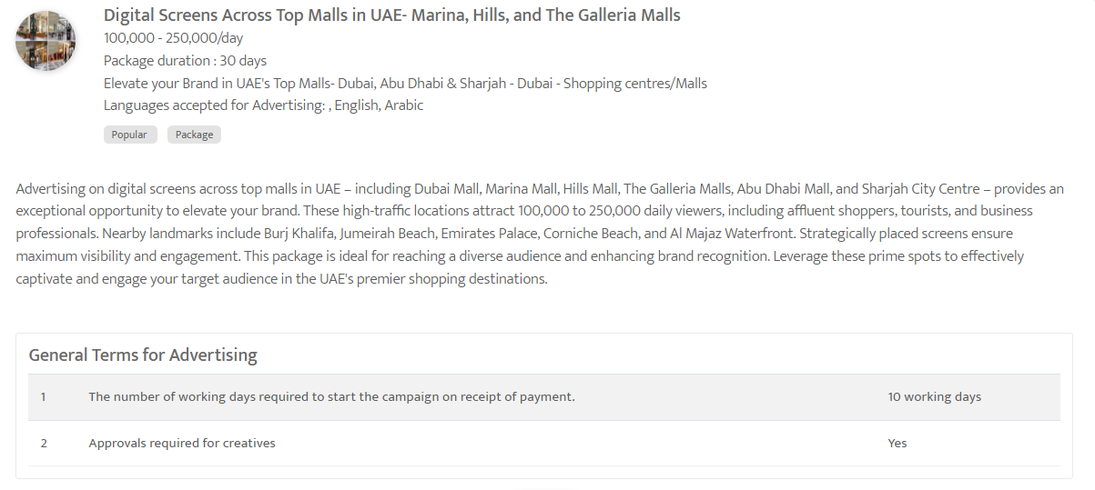

Slide 67
Theater ads

Slide 68
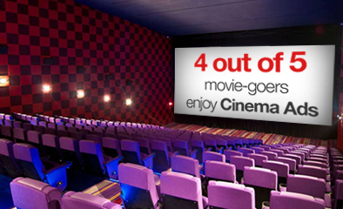
Cinema Advertising across the UAE - Abu Dhabi
Cinema Advertising with "Follow The Movie Package"- United Arab Emirates
Out of Home

Slide 69
Cinema Advertising across the UAE - Abu Dhabi
Cinema Advertising with "Follow The Movie Package"- United Arab Emirates
Out of Home
Details
Number of Screens: 21
Number of production: 1

Slide 70
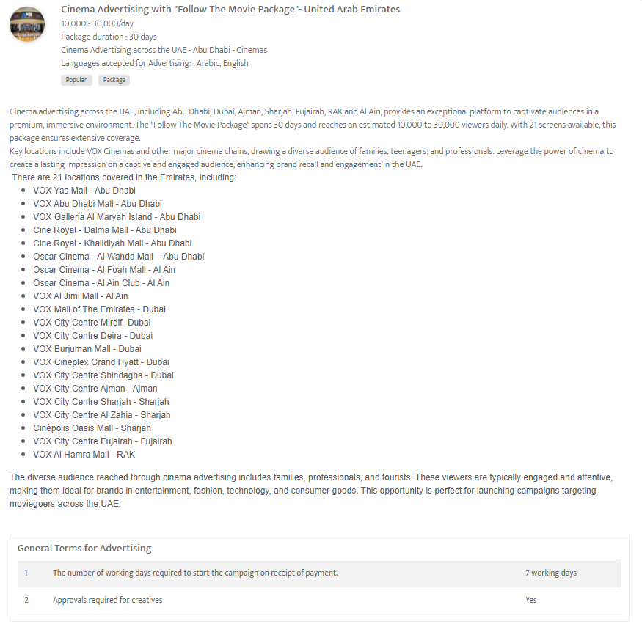

Slide 71
Radio

Slide 72
Hit 96.7 FM - The Big Breakfast Club - 4 weeks Sponsorship Package
United Arab Emirates
Radio

Slide 73
Hit 96.7 FM - The Big Breakfast Club - 4 weeks Sponsorship Package
United Arab Emirates
Radio
Details
Time: 06:00 - 11:00
Estimated number of spots: 40
Number of production: 1

Slide 74
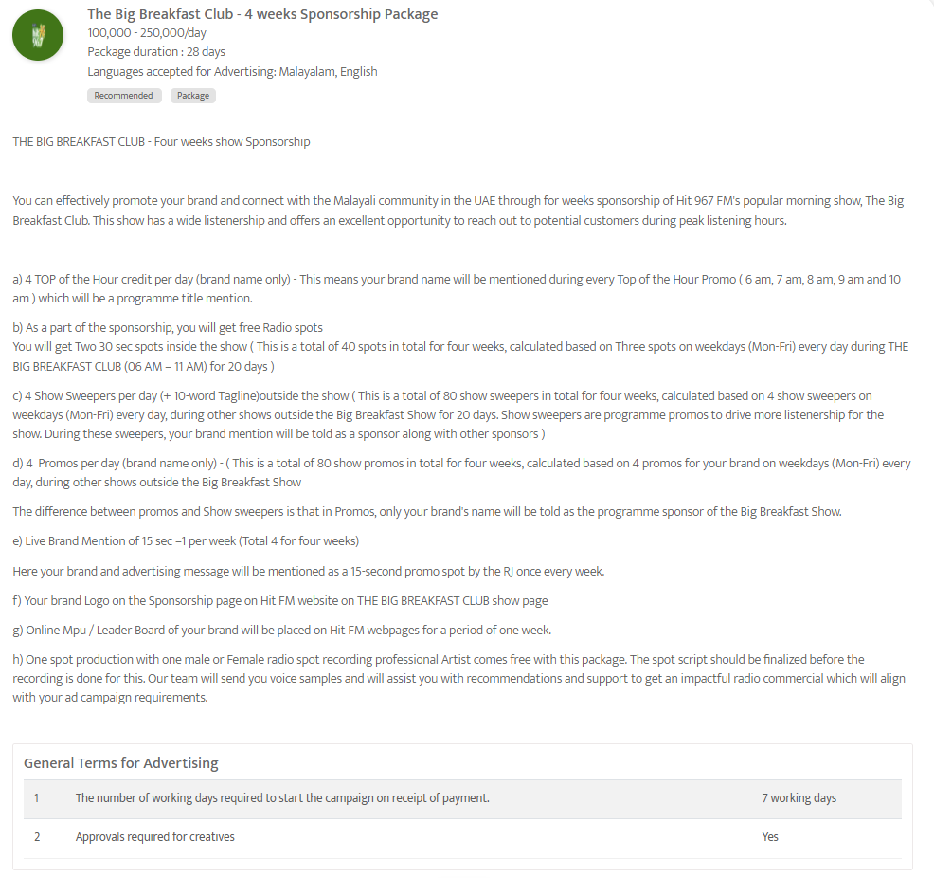

Slide 75
Virgin Radio 104.4 FM - 30-sec spot Ad during evening show 'The Kris Fade Show's Hour of Power'
United Arab Emirates
Radio

Slide 76
Virgin Radio 104.4 FM - 30-sec spot Ad during evening show 'The Kris Fade Show's Hour of Power'
Radio
Details
Time band: Evening
Spot Duration (seconds): 30 sec
Time: 18:00 - 19:00
Number of production: 1

Slide 77
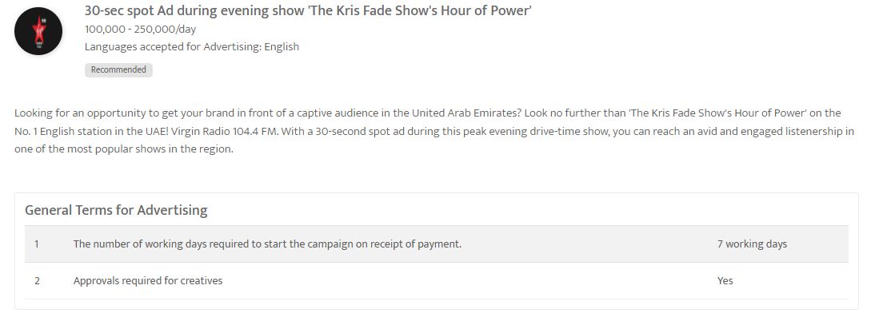

Slide 78
Dubai Eye 103.8 FM, United Arab Emirates - 'The Business Breakfast' 8 weeks show sponsorship,
Dubai Eye 103.8 FM, United Arab Emirates
Radio

Slide 79
Dubai Eye 103.8 FM, United Arab Emirates - 'The Business Breakfast' 8 weeks show sponsorship, Dubai Eye 103.8 FM, United Arab Emirates
Radio
Details
Time: 06:00 - 10:00
Estimated number of spots: 112
Number of production: 1

Slide 80
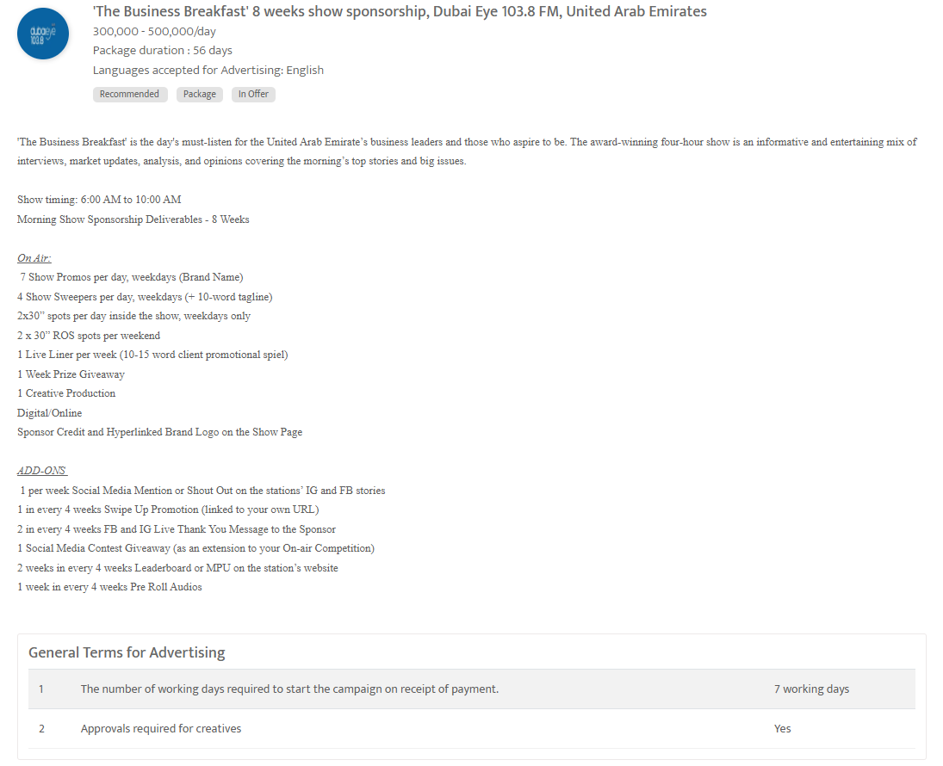

Slide 81
Thank You
media@masscomglobal.com | www.masscomglobal.com
Masscom Global FZE, Office No: 220, One UAQ Building, UAQ Free Trade Zone, Umm Al Quwain, United Arab Emirates.

